Slide 1
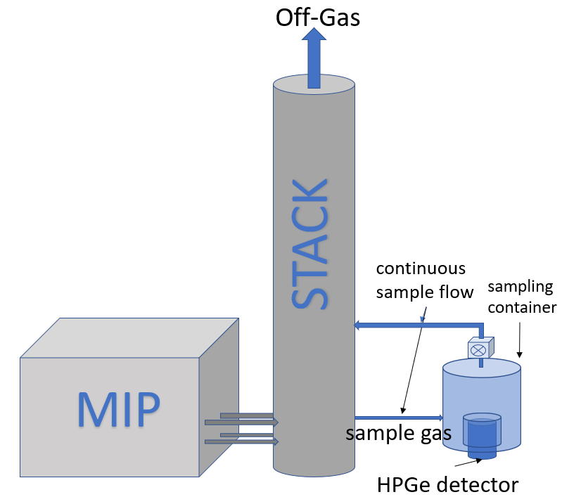
STAX Data Flow and Security
STAX Software
User 1
STAXDATA.NET
Encrypted
Email Subscription
(S/MIME)
Encrypted
Email
(S/MIME or proprietary)
User 2
Secure Download
...
HTTPS
Viewing
...
Data Receiving
Data Distribution
User n
Data processing and storage
Access control to authorized users
Data analysis & visualization
Network monitoring
HTTPS

Slide 2
STAX Data Flow and Security
Data messages generated at MIP are securely transferred to the STAX data server, by using:
HTTPS encrypted communications protocol, or
Encrypted and digitally signed emails (using S/MIME or proprietary encryption)
Data is only accessible to authorized users, via the following mechanisms:
Emails subscriptions with S/MIME encrypted, digitally signed email messages, for each of the five types of data products
Secured download using an automated, scripted procedure (wget)
Secured download by user interaction with the STAX application interface from a web browser
Multiple data viewing options from the STAXDATA.NET Web user interface

Slide 3
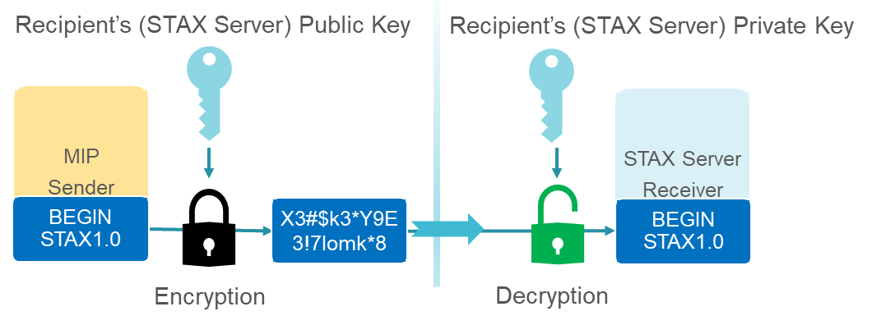
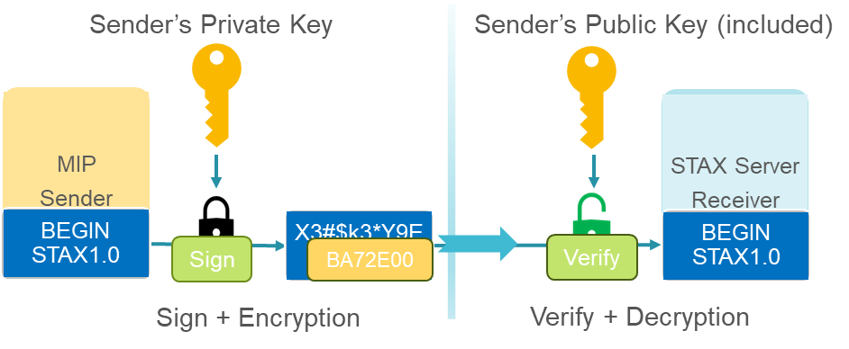
Secure Email Messages
STAX email messages privacy is protected by using encryption, where messages are converted from readable plain text into scrambled cipher text for transmission.
S/MIME standard encryption and a proprietary encryption are supported.
STAX software secures email messages by using a digital signature, including a certificate and public key. Messages signed using the sender’s private key are verified at the STAX Server using the public key that is included in the message.
All data messages transmitted by email are encrypted and digitally signed at the MIP, then decrypted and verified upon receipt at the STAX Server.

Slide 4
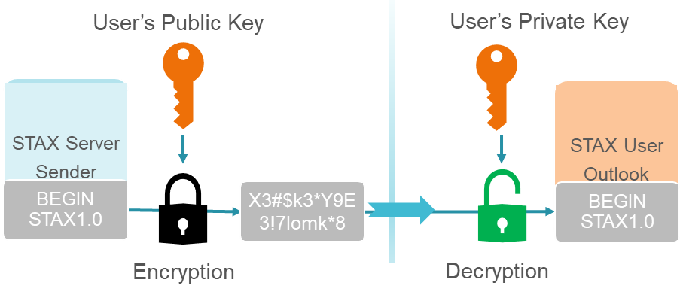
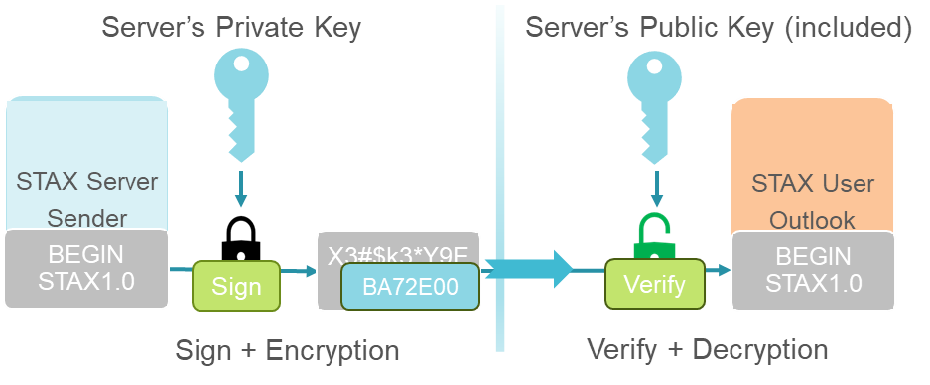
STAX User Emails
The privacy of the emails distributed from the STAX server to the users is protected by using S/MIME encryption, supported by Outlook email client.
STAX user email messages are secured by using a digital signature originating from the STAX server’s digital ID.

Slide 5
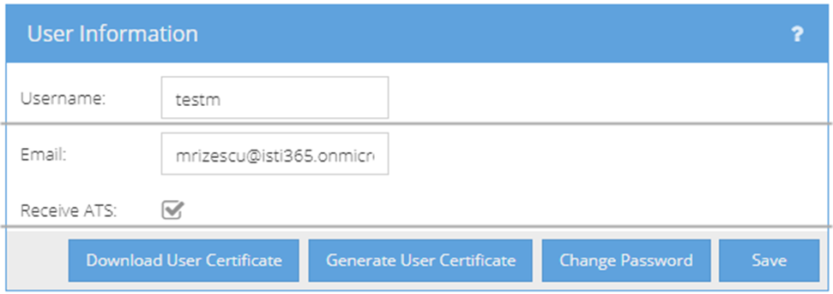
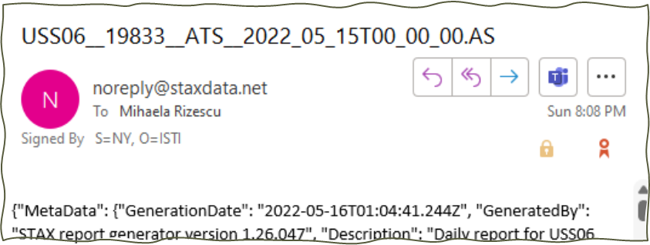
STAX User Certificates
From the STAX web interface, users can generate their own encryption user certificate, and download a copy to be installed and used for decryption in Outlook.

Slide 6
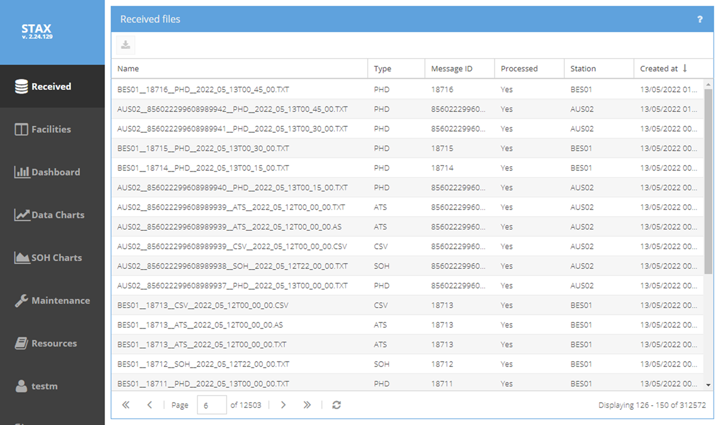
STAX User Access (Data download)
The STAX user can browse and securely download data for authorized stations from the STAX web interface.
Data filtering options, e.g., by station name or data type are available.
Alternatively, a wget script can be used to automate retrieval for all files of a selected station, data type and collection day.

Slide 7
STAX Project: Data access, control and security
M. Rizescu, M. Auer, K. Frechette, S. Hellman
mihaelarizescu@isti.com

