Slide 1


1st Nuclear Explosion Signal Screening Open Inter-Comparison Exercise 2021
Christian Maurer¹, Paul Skomorowski¹, Ramesh S. Sarathi², Alexander Hieden¹, Boxue Liu³, Jonathan Baré³, Jerome Brioude⁴, Delia Arnold Arias¹, Yuichi Kijima³, Brian T. Schrom², Jennifer M. Mendez², Anne Tipka³, Jolanta Kusmierczyk-Michulec³, Martin Kalinowski³, and Robin Schoemaker³
¹Zentralanstalt fuer Meteorologie und Geodynamik (ZAMG)
²Pacific Northwest National Laboratory (PNNL)
³Comprehensive Nuclear-Test-Ban Treaty Organization/International Data Center (CTBTO/IDC)
⁴Laboratoire de l'Atmosphère et des Cyclones (LACy)

Slide 2
1. Test data set structure
48 date-times * 53 grid points * 23 IMS time series = 58512 data files
Uniformly distributed over the globe with denser sampling of latitudes compared to longitudes
Samples for the whole year 2014 according to actual data availability
Each data file potentially impacted by one explosion
Four per month
Immediate release, 0.92% venting
24 hours containment, 10% release within one hour
2544 explosion scenarios:
No mixing of explosions.
Burnett et al. (2019) underwater& IDC underground source term:
At maximum 14 days are influenced by a hypothetical explosion.
Sample meta data included (MDC, LC ect.).
The full data set cannot be processed/handled during the 1st Nuclear Explosion Signal
Screening Open Inter-Comparison Exercise 2021 -> reduction to 424 scenarios
(8 date-times, four target periods for ATM) - not necessarily explosions

Slide 3
2. Participants
Name | Institution | Country | Confidential emission data (IRE & ANSTO) requested | ATM + meteorology combination | Level 1 results (ATM only) submitted | Level 2 & 3 results (screening of test data set with own methods) to be submitted
P. de Meutter, A. Delcloo & C. Gueibe | SCKCENRMI | Belgium | Yes | FLEXPART V10.4 + ECMWF | Yes | Yes
S. J. Leadbetter | MetOffice | UK | Yes | NAME 8.3 + MetOffice Unified Model | Yes | No
J. Kusmierczyk-Michulec | CTBTO („XeBet“) | Austria | - | FLEXPART V9 + ECMWF | Yes (Xe-133 only) | No
M. Schoeppner | IAEA | Austria | Yes | FLEXPART V9 + ECMWF | Yes | Not likely
P. Tayyebi | NSTRI, AEOI | Iran | Yes
J. Roberts, J. Lucas | US NDC | US | Yes
S. Wang, Q. Li, Y. Zhao | BRL | China | Yes
U. A. Kadiri, H. A. Muhammed, I. Dodo | CGG | Nigeria | Yes
A. Quérel, D. Quélo, O. Saunier | IRSN | France | Yes
M. Goodwin, D. Chester | AWE | UK | Yes
R.S. Sarathi | PNNL | US
So far 4 participants, international interest

Slide 4
3a. Evaluation: Detection Power
Question: “Is a measurement an anomaly (regardless of what has caused it)?”
Approach based on ATM of civil sources (use of Level 1 results - tricky):
  Calculate residuals between the test data set values and a participant’s civil
background estimates per IMS station and separately for all radioxenon isotopes.
  Filter the test data set according to LC in order to prevent accounting for samples below LC that could be solely due to the detector background.
  Claim a detection if a certain percentile value of all the residuals is exceeded for a sample.
  Calculate the true positive and false positive rates for any of the four xenon
isotopes.
  Optionally: Apply a moving average [t-1,t+1] to both time series before residual
calculation to prevent relying on single sample values.

Slide 5

3b. Evaluation: Screening Power
Question: "Has an underground or underwater nuclear explosion to be assumed based on
isotopic ratios?”
Approach:
Based on all claimed (true and false) positives according to detection power evaluation and on multi-isotope detections (2 to 4 isotopes) evaluate true positive and false positive rates for:
  Three and four xeonon isotope discrimination relations (Kalinowski et al., 2010):
AC_{x} u² ACy u² AC_{x}
2
x,testset
AC²
R = ; u² R = R² + ; u² AC_{x} = ERR
AC
+
x,modelled
S_{x}
; S : detector sensitivity
2
2
x
AC_{y} AC_{y}
AC_{x}
^{R}a,b ^{< K}a,b,c,d ^{R}c,d^{ma,b,c,d}
Comparison to xenon flags for xenon isotope pairs: Xe-133m/Xe-131m > 2, Xe-135/Xe-133 > 5, Xe-133m/Xe- 133 > 0.3 and Xe-133/Xe-131m > 1000
  Bayesian limits (Zaehringer and Kirchner, 2008):
𝐴𝐶⁻ = 𝐴𝐶 + 𝑢(𝐴𝐶 )𝑁𝑂𝑅𝑀𝑆𝐼𝑁𝑉(1 − 0.975𝑁𝑂𝑅𝑀𝐷𝐼𝑆𝑇(𝐴𝐶 𝑢(𝐴𝐶 ))
𝑥 𝑥 𝑥 𝑥 𝑥
𝐴𝐶⁺ = 𝐴𝐶 + 𝑢(𝐴𝐶 )𝑁𝑂𝑅𝑀𝑆𝐼𝑁𝑉(1 − 0.025𝑁𝑂𝑅𝑀𝐷𝐼𝑆𝑇(𝐴𝐶 𝑢(𝐴𝐶 ))
_{R}−
𝑥
𝑥 𝑥
𝑥
𝑥
= AC⁻ AC⁺; R⁺ = AC⁺ AC⁻
x,y x y x,y x y
b) Fieller’s theorem (Axelsson et al., 2014):
_{𝑅}±
₌ 1
(𝐴𝐶_{𝑥} 𝐴𝐶_{𝑦} − 𝜌4𝑢_{𝑥} 𝑢_{𝑦}) ∓
(𝐴𝐶_{𝑥} 𝐴𝐶_{𝑦} − 𝜌4𝑢_{𝑥} 𝑢_{𝑦})²−(𝐴𝐶² − 4𝑢²)(𝐴𝐶² − 4𝑢²)
𝑥 𝑥 𝑦 𝑦
𝑥,𝑦
𝐴𝐶² − 4𝑢²
𝑥 𝑥

Slide 6



3c. Evaluation: Timing Power
Question: "Can we determine time zero +/- uncertainty within a predefined time window?“
Approach:
1. For Xe-133 and Xe-133m: 𝑅
𝑡 =
_{𝑒}^{−𝜆}133𝑚^{𝑡}
133𝑚/133
1
^{𝜆}133
^{𝜆}133^{−𝜆}133𝑚 ^{𝑅}133𝑚/133 ⁰
𝑒^{−𝜆}133𝑚^{𝑡}
_{1−𝑒}−(𝜆₁₃₃−𝜆_{133𝑚})𝑡 _{+ 𝑒}−𝜆₁₃₃𝑡
2. If Xe-133m is not present: E.g., 𝑅_{135/133} 𝑡 = 𝑅_{135/133} 0 𝑒^{−(𝜆135−𝜆133)𝑡}
Analogous, simple relations for Xe-133m/Xe-131m and Xe-133/Xe-131m (no parent-daughter decay).
3. If Xe-133m is present: E.g., 𝑅 𝑡 =
_{𝑒}−𝜆₁₃₅𝑡
135/133
1
¹ 𝑒^{−𝜆}133𝑚^{𝑡}
^{𝜆}133
_{1−𝑒}−(𝜆₁₃₃−𝜆_{133𝑚})𝑡 _{+ 𝑒}−𝜆₁₃₃𝑡
^{𝑅}135/133𝑚 ^{0 𝜆}133^{−𝜆}133𝑚 ^{𝑅}135/133 ⁰
Analogous relation for Xe-133/Xe-131m (Parent-daughter decay to be considered if Xe-133 is involved).
4. Evaluate timing success rates based on single samples which where found to be true positives after detection and screening power evaluation and on a 10% tolerance criterion.
For the purpose of estimating the uncertainty the release scenarios include one case at hour zero (immediate release) and another at 24 hours as well as U-235 and Pu-239 fission materials.
 | Uncertainty | Tolerance (10% of the total uncertainty)
Xe-135/Xe-133 | 57 h | 6 h
Xe-133/Xe-131m | 45 d | 108 h
Xe-133m/Xe-131m | 24 d | 58 h
Xe-133m/Xe-133 | 16 d | 38 h

Slide 7
3d. Evaluation: Location and Magnitude estimation Power
Approach: Very limited evaluation
  Location Power: Calculate the percentage of cases for which there are 1) two, 2) three or 3) more than three detections related to a nuclear explosion regardless of the isotope. (PSR fields can be calculated blending different isotopes as well as detections and non-detections. Minimum is one detection and two non-detections.)
  Magnitude estimation power: If there are two detections related to a nuclear explosion, location and releases for two isotopes could be estimated. If there are three detections related to a nuclear explosion, location and releases for three isotopes could be estimated. If there are four detections, location and releases for two or up to four isotopes could be estimated (depending on whether there are different two- or three-isotope ratios involved in case two two- or three-isotope ratios are present). Count the number of different detected isotopes for each of the different above settings (i.e., 1) two, 2) three or 3) more than three detections regardless of the isotope).
Include only samples in the statistics which where found to be true positives after detection and screening power evaluation.

Slide 8
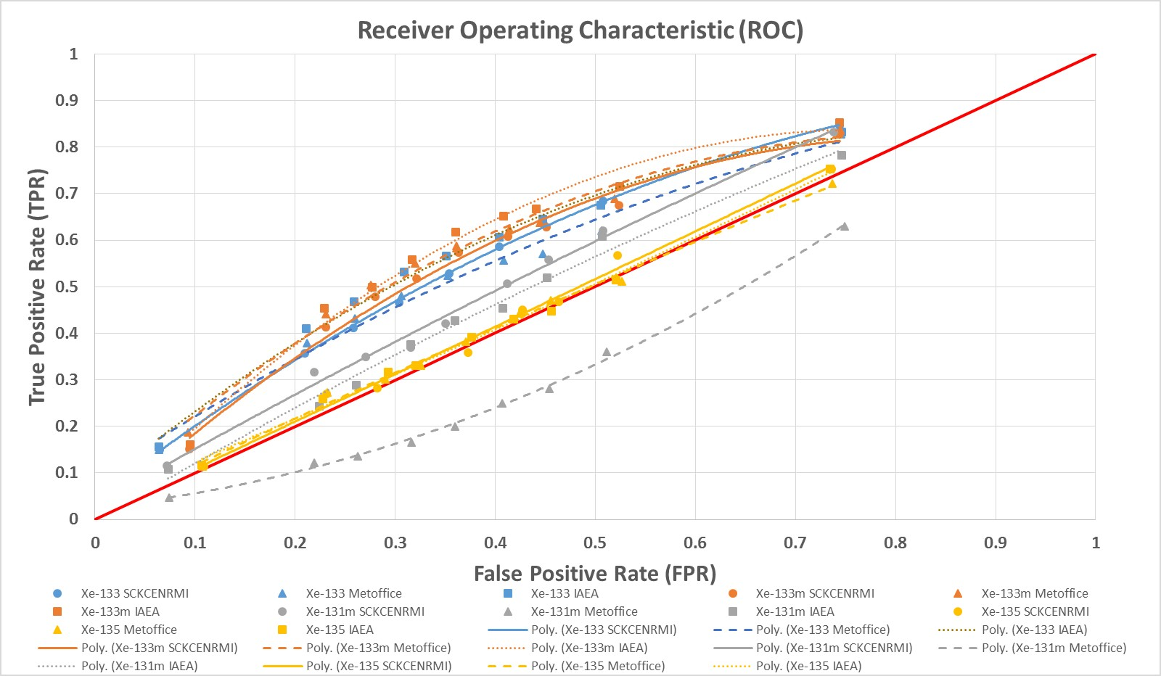
4a. Detection power based on ATM for civil sources
Models tend to produce similar output (-> see ensemble analysis of 3rd ATM Challenge).
There is some skill for Xe-
133 and Xe-133m.
There is hardly/no skill for Xe-131m and Xe-135. But ATM runs (especially source terms) need to be checked!
The optimum residual threshold can be empirically determined, ranging approximately from the 55th to 70th percentile (depending on the isotope and the
specific ATM run).
Overpredicting ATM run for Xe-131m!

Slide 9
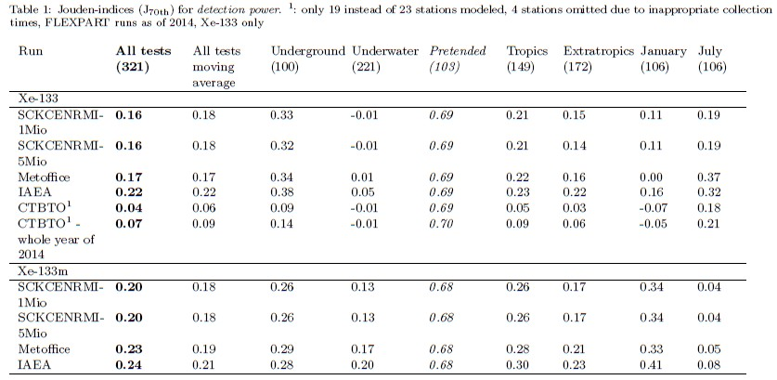
4b. Detection power for different data sets
Jouden index = Sensitivity (= TPR) + Specificity (= 1-FPR) -1; [-1,1]
Slightly higher overall detection power for Xe-133m than for Xe- 133 (-> source term + civil Xe background)
Higher detection power for underground compared to underwater tests (-> source term)
No detection power for Xe-133, but small one for Xe-133m for underwater tests (-> source term)
Higher detection power for tropics compared to extratropics (-> lower civil Xe background in the tropics?)
Considerable differences between seasons (-> ?)
Longer period with
civil background
predictions -> better results

Slide 10
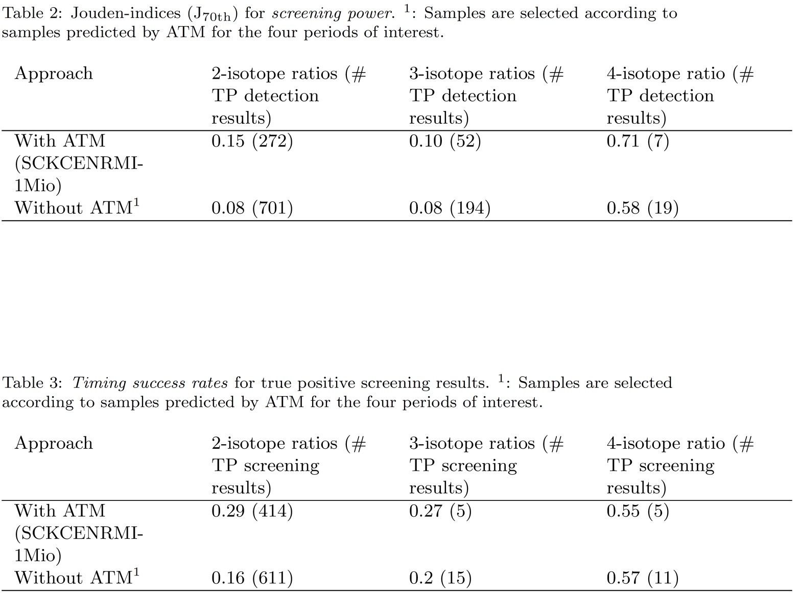
4c. Screening & timing power with/without ATM support
Use of ATM enhances screening and timing power results to different extents. Largest improvements are seen for 2-isotope screening and subsequent timing.
Only combination of ATM + 4 isotope ratio screening enables a more save claim of a nuclear test (J > 0.7)

Slide 11
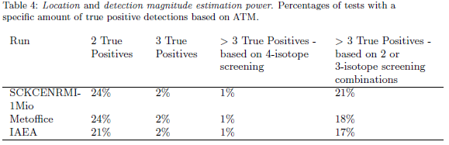
4d. Location and magnitude power counting statistics

Slide 12
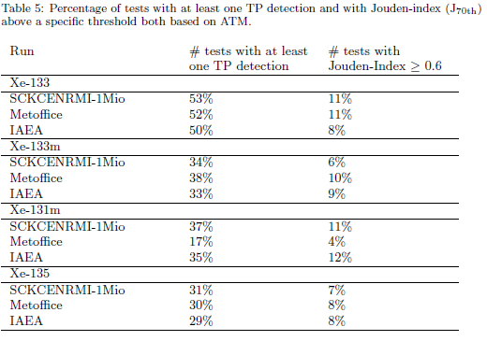
5. The problem of false positives
We could detect half of the tests based on Xe-133, 23 IMS stations and radioxenon systems as of 2014. But accompanied by a very high average false positive rate per test!
J above 0.7 is only reached for one test, for Xe-133 and two participants!

Slide 13
6. Preliminary conclusions
Overall detection power based on different ATM runs is similar.
Detection power per isotope based on ATM depends on the combined effects of explosion source term magnitude, decay and magnitude of average civil background (as well background representation by ATM). ATM results need to be checked.
There is a slight overall positive impact on detection power for Xe-133 (J ranges from
0.16 to 0.22) and for Xe-133m (J ranges from 0.20 to 0.24). This is likely related to high fission yields in combination with long half-lifes of these radioxenon isotopes.
There is a measurable positive impact on screening and timing power results from detection power analysis based on ATM.
Civil background calculated via ATM needs to be clearly improved. Approach of nudging ATM simulations towards (IMS) observations as outlined in Zwaaftink et al. (2018, https://gmd.copernicus.org/articles/11/4469/2018/gmd-11-4469-2018-assets.html) to overcome effects of source term and transport errors.

Slide 14
7. Remarks and references
Please mind the exercise deadline of June, 30th, as well as templates for submitting results (Level
1 and Level 2+3)!
Publication "Third international challenge to model the medium- to long-range transport of radioxenon to four Comprehensive Nuclear-Test-Ban Treaty monitoring stations” has just been accepted by the Journal of Environmental Radioactivity.
A. Axelsson, A. Ringbom, M. Aldener, T. Fritioff, and A. Mörtsell (2014): The Impact of System Characteristics on Noble Gas Network Verification Capability for CTBT. Report No. FOI-R-3856-SE, ISSN-1650-1942, Stockholm, Sweden.
M. B. Kalinowski, A. Axelsson, M. Bean, X. Blanchard, T. W. Bowyer, G. Brachet, S. Hebel, J. I. McIntyre, J. Peters, C. Pistner,
M. Raith, A. Ringbom, P. R. J. Saey, C. Schlosser, T. J. Stocki, T. Taffary, and R. K. Ungar (2010): Discrimination of Nuclear Explosions against Civilian Sources Based on Atmospheric Xenon Isotopic Activity Ratios. Pure and Applied Geophysics 167, 517–539.
vDEC-Virtual Data Exploitation Centre. CTBTO, https://www.ctbto.org/specials/vdec/
M. Zähringer and G. Kirchner (2008): Nuclide ratios and source identification from high-resolution gamma-ray spectra with Bayesian decision methods. Nuclear Instruments and Methods in Physics Research A.
THANK YOU FOR YOUR ATTENTION!

Slide 15
Auxiliary material I
Differences regarding the metrics as used in this study compared to the FOI study:
Detection Power: Percentile is used as threshold instead of the MDC. The use of the MDC for the purpose of detecting a nuclear explosion is challenged by the project team in general. The use of ATM to model the civil background probably makes the use of a threshold that depends on the individual modeled time series at a specific IMS station more appropriate.
Location Power: Sample counting approach only – very limited evaluation
Rejection Power in the FOI study vs. Screening Power in the current evaluation:
No generation of false scenarios, model trajectories, respectively.
Timing Power: Xe-135/Xe-133 is not the only ratio considered, the current
evaluation also covers Xe-133/Xe-131m, Xe-133m/Xe-131m and Xe-133m/Xe-
133. But no least-square fitting for multiple ratios is applied.

Slide 16
Auxiliary material II
2 isotope ratios calculated directly for test data set values (no residual approach): Ratios Xe- 133/Xe-131m and Xe-133m/Xe-131m are never evaluated likely because of the simultaneous occurence of Xe-133 and Xe-133m with >= LC values. Thus, Xe-133m/Xe-133 vs. Xe-133m/Xe- 131m can be evaluated.
3 isotope ratios calculated directly for test data set values (no residual approach): Ratio: Xe- 135/Xe-133 vs. Xe-133m/Xe-133 is never evaluated likely because of the simultaneous occurence of Xe-135 and Xe-131m with >= LC values. Thus, the 4-isotope relation can be evaluated.
Test data set (excluding ACs < 0 and ACs impacted by explosions) versus related background
values averaged over all stations and tests: Xe-133m and Xe-135 source terms too low?
1. SCKCENRMI-1Mio: Xe-133: 0.428 vs. 0.248, Xe-133m: 0.141 vs. 0.002 (factor 70), Xe-131m: 0.052 vs. 0.003, Xe-135: 0.212 vs. 0.005 (factor 40)
2. IAEA: Xe-133: 0.453 vs. 0.446, Xe-133m: 0.150 vs. 0.006 (factor 25), Xe-131m: 0.056 vs. 0.050, Xe-135: 0.210 vs. 0.007 (factor 30)
3. MetOffice: Xe-133: 0.438 vs. 0.739, Xe-133m: 0.143 vs. 0.010, Xe-131m: 0.055 vs. 0.262, Xe-135: 0.212 vs. 0.022 (Run needs to be checked - OVERPREDICTING!)
Spurious differences in overall level of Xe-131m predicted by participants (SCKCENRMI and IAEA):
1. SCKCENRMI-1Mio: Xe-133: 0.193, Xe-133m: 0.002, Xe-131m: 0.003, Xe-135: 0.004
2. IAEA: Xe-133: 0.344, Xe-133m: 0.004, Xe-131m: 0.051, Xe-135: 0.005
3. MetOffice: Xe-133: 0.745, Xe-133m: 0.007, Xe-131m: 0.243, Xe-135: 0.018 (Run needs to be checked - OVERPREDICTING!)

