Slide 1
DE LA RECHERCHE À L’INDUSTRIE
Simulation of the ¹³³Xe background at the global scale:
Use of NCEP ensemble data to factor in meteorological uncertainties
Generoso S., Achim P., Morin M., Gross P., Douysset G.
Commissariat à l’énergie atomique et aux énergies alternatives - www.cea.fr

Slide 2
Introduction
Use of STAX data [WOSMIP 2021]
Implementation of STAX data from IRE (Fleurus, Belgium) in our automated simulation of the radioxenon background
Summary of lessons learned from analysis of a 1-year simulation dataset
Use of STAX data & NCEP GEFS meteorological data
Simulations conducted with a method similar to our automated process, for a 1 year period (Nov. 2020 – Nov. 2021), and only with IRE emissions (Belgium)
- with NCEP / GFS data (deterministic)
- with NCEP / GEFS data (Ensemble)
Results compared to measurements at Paris (France) and DE33-Freiburg (Germany)
Share feedbacks from a National Data Center perspective on using ensemble meteorological data compared to deterministic data

Slide 3
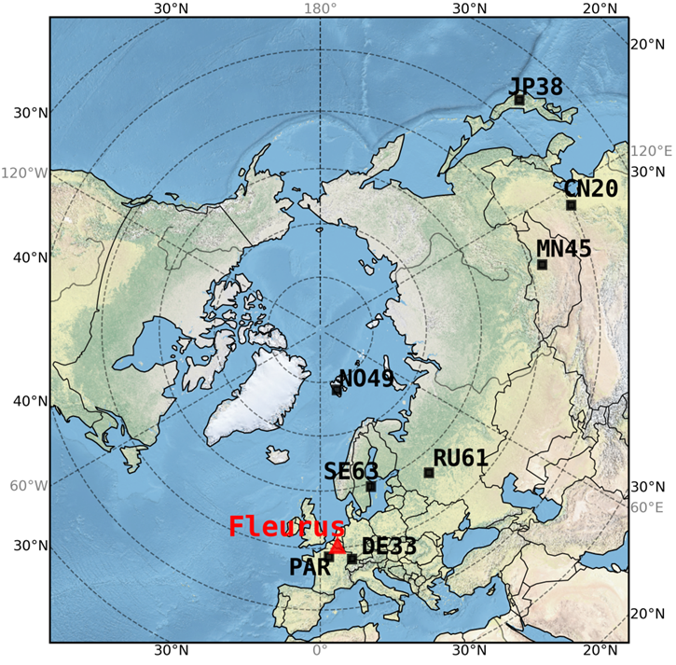
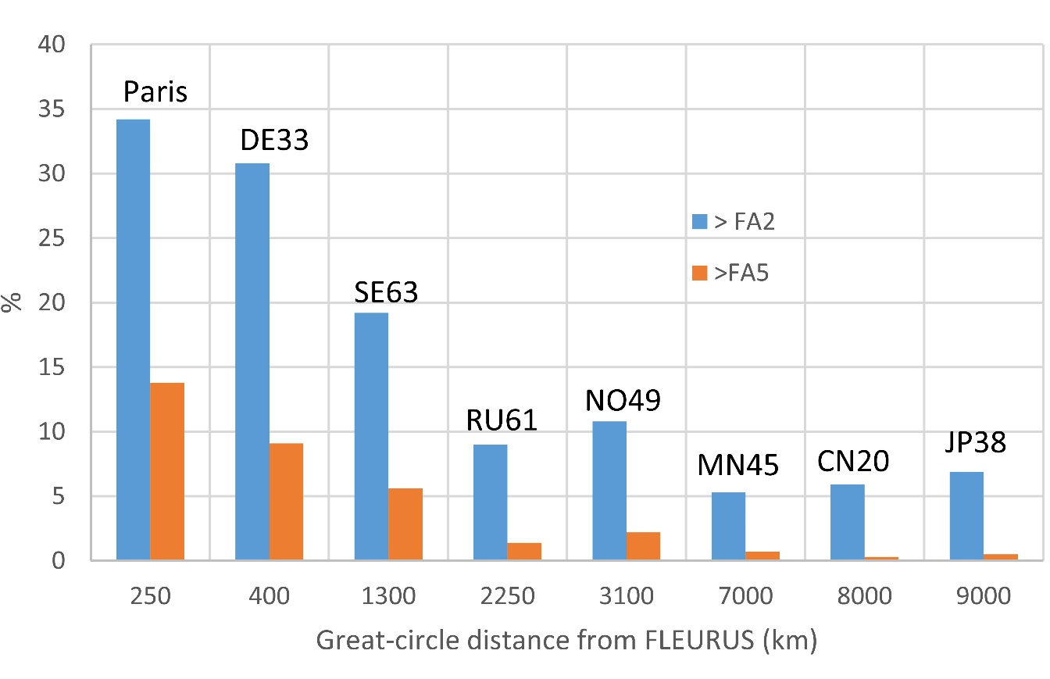
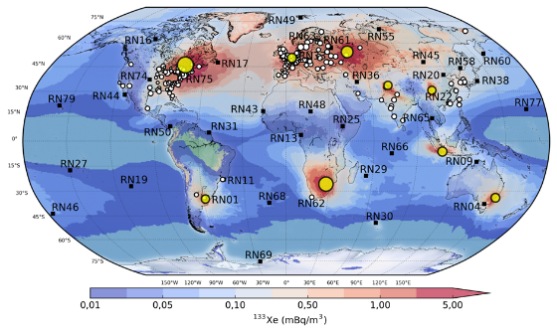
Use of STAX data (versus a constant a priori) [WOSMIP 2021]
Percent of simulation results that differ by a factor of more than 2 (blue) and 5 (red) between the “A PRIORI” and “STAX” simulations.
Notable differences in simulations < 1 500-2 000 km from Fleurus No detectable differences > 2 000 km
Simulations improved notably with respect to timings of peaks
However, STAX data alone are not sufficient to fully reproduce the day-to-day variability → other uncertainties in ATM
Results in agreement with other studies and National Data Centers
STAX data are implemented in CEA automated daily simulations
Generoso et al., submitted to JER special issue, 2021

Slide 4
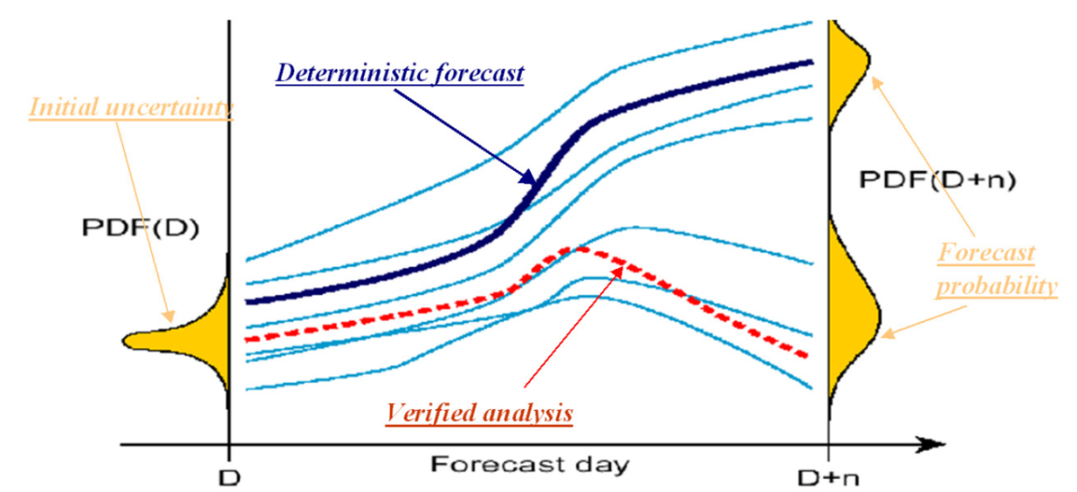
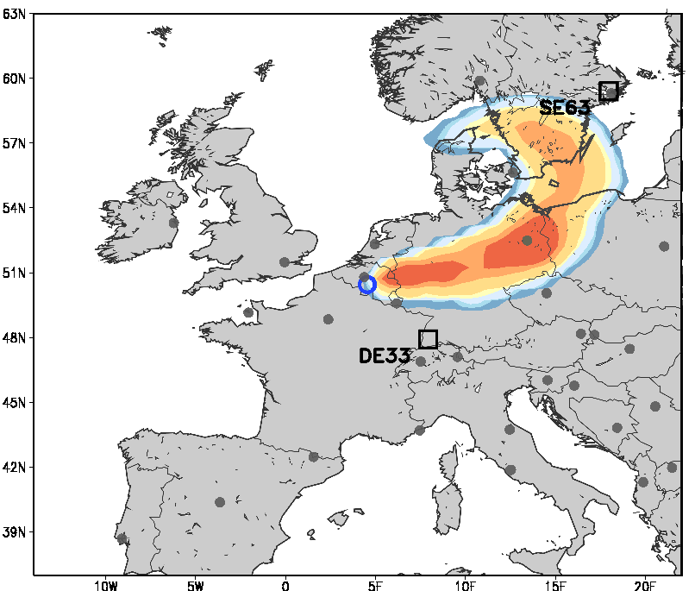
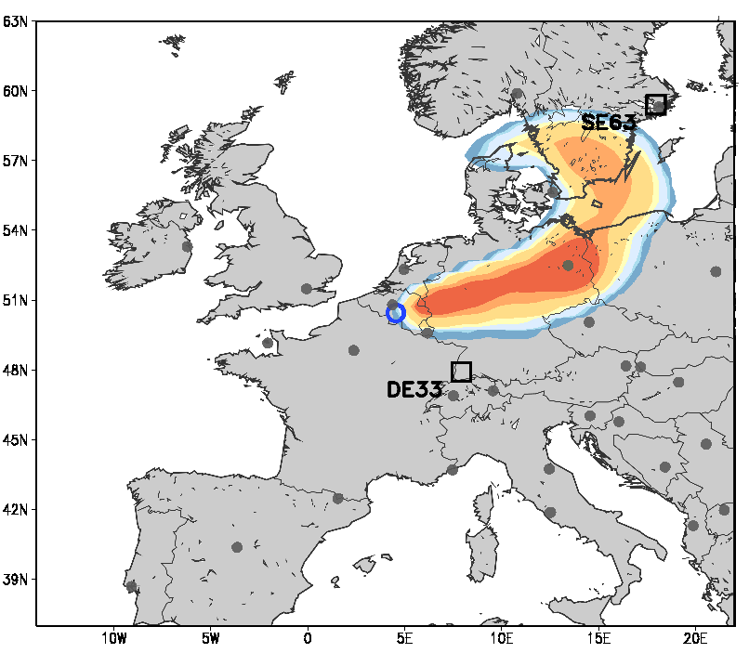
NCEP GFS and GEFS (Global Ensemble Forecast System)
Concretely, for the ATM:
From NCEP Global Ensemble Forecast System (GEFS) – Review, Y. Zhu, NCEP/NWS/NOAA, March 2011
GFS
Deterministic
Flexpart
Control
c00
Flexpart
GEFS data come at a cost of a lower resolution than the deterministic run
General Features
- “Deterministic runs (e.g., GFS) usually have more skill than any individual ensemble member due to superior resolution”
p01
Flexpart
GEFS (31 perturbed members)
GFS (interpolated at 0.5°)
Initial model :
~13km → 10 days,
~34km from 10 to 16 days
64 vertical layers
.
.
.
.
.
.
.
.
.
Perturbed
- “Ensemble mean can be more skillful than a higher-resolution deterministic run, especially beyond ~3 days”
GEFS V12 since Sep. 2020 (interpolated at 0.5°)
Initial model :
~25km -> 16 days, 64 vertical layers
p30
Flexpart
Ensemble Prediction System, E. S. Blake and M. J. Brennan, National Hurricane Center, March 2016

Slide 5
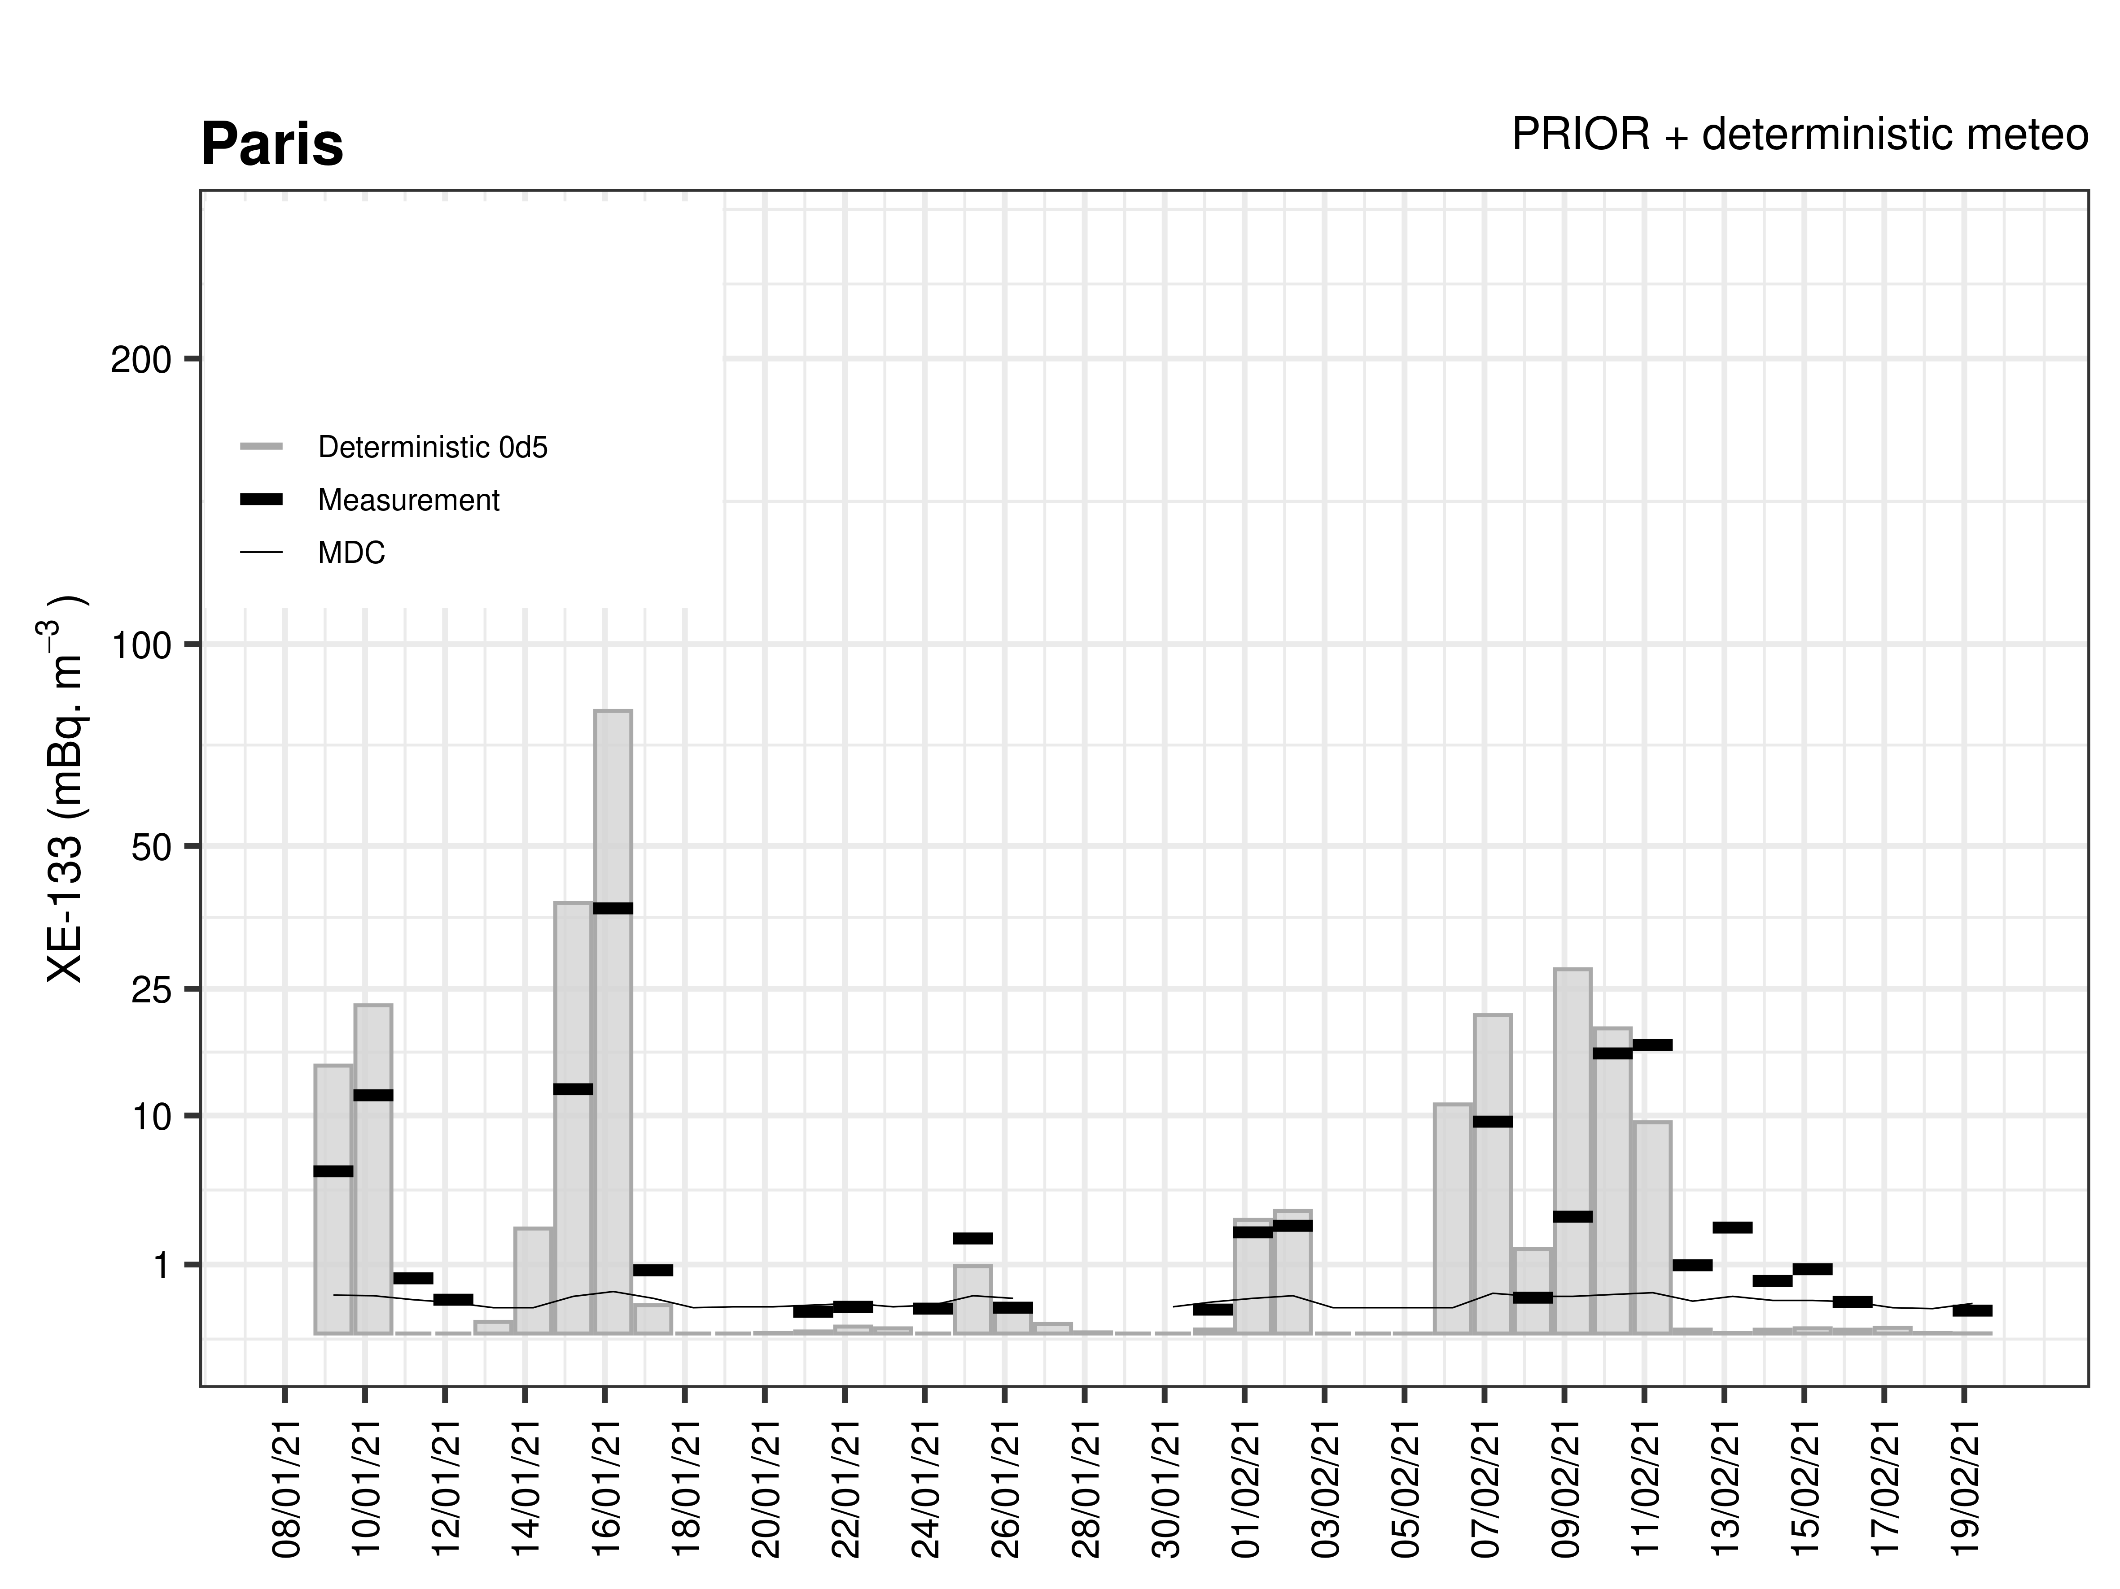
Time series at station location – Zoom in January 2021
FLEXPART v9.02
GFS / GEFS 0.5° / 6 hr
Output 0.5°x0.5 / 12 hr
CTL=1
24 hour average from 17h to 17h as measurements
Only emissions from IRE

Slide 6
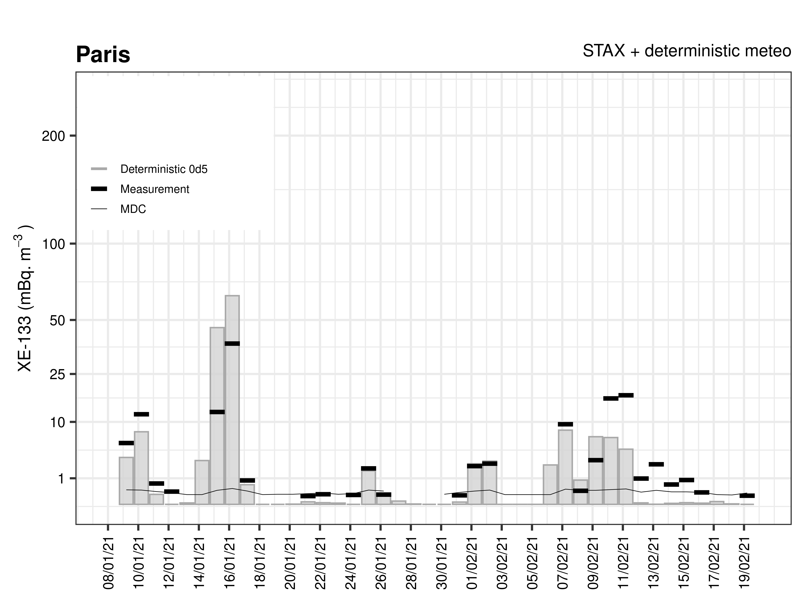
Time series at station location – Zoom in January 2021
FLEXPART v9.02
GFS / GEFS 0.5° / 6 hr
Output 0.5°x0.5 / 12 hr
CTL=1
24 hour average from 17h to 17h as measurements
Only emissions from IRE

Slide 7
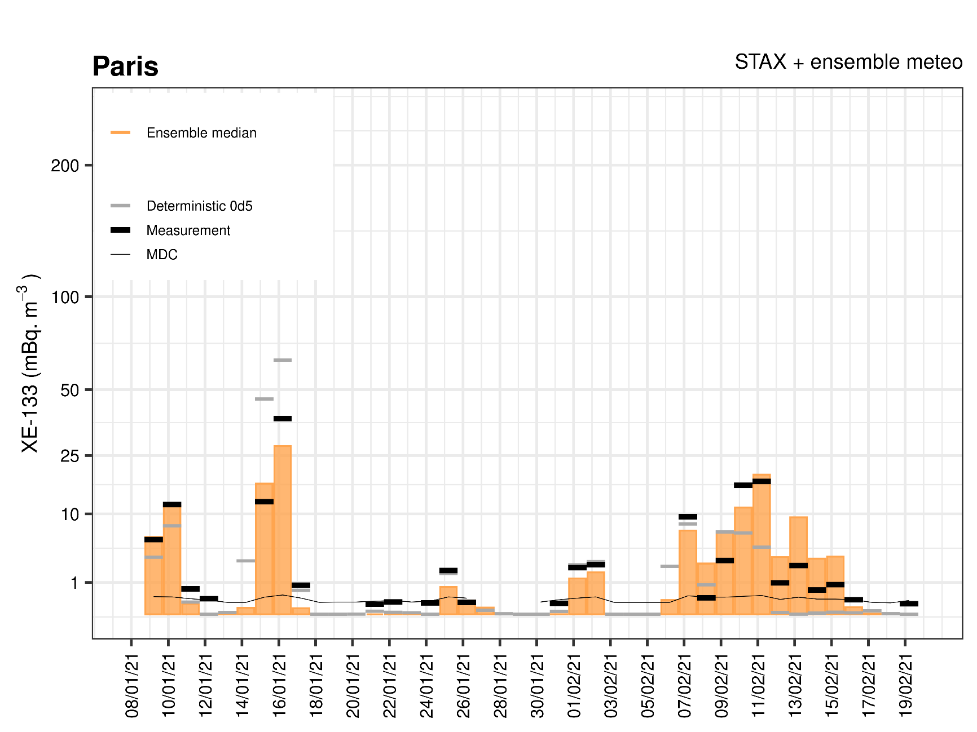
Time series at station location – Zoom in January 2021
FLEXPART v9.02
GFS / GEFS 0.5° / 6 hr
Output 0.5°x0.5 / 12 hr
CTL=1
24 hour average from 17h to 17h as measurements
Only emissions from IRE

Slide 8
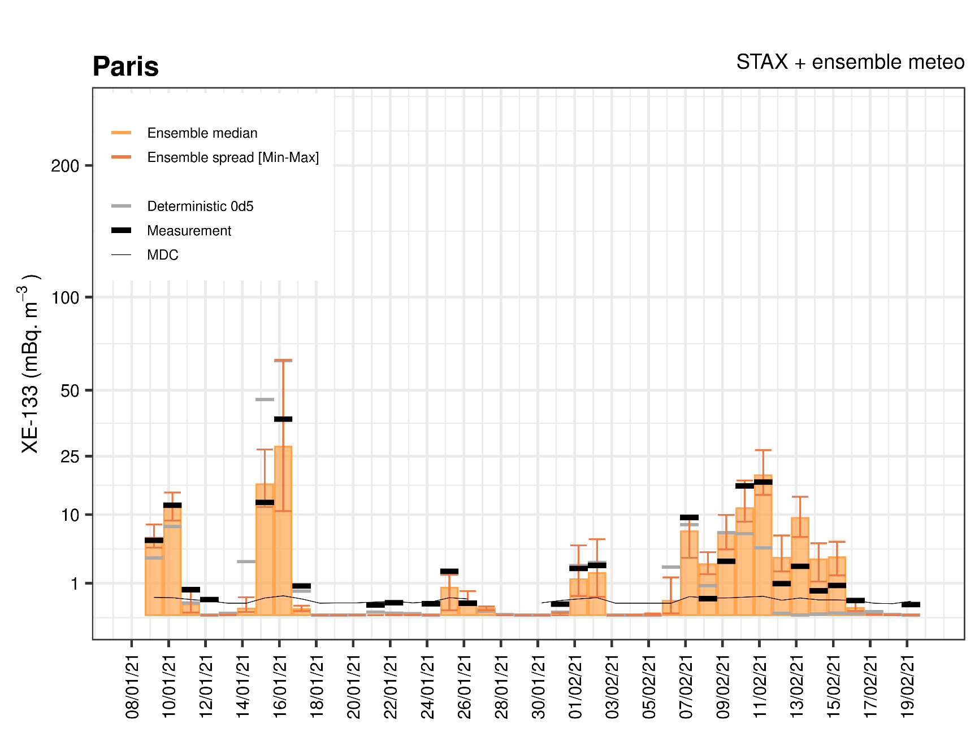
Time series at station location – Zoom in January 2021
FLEXPART v9.02
GFS / GEFS 0.5° / 6 hr
Output 0.5°x0.5 / 12 hr
CTL=1
24 hour average from 17h to 17h as measurements
Only emissions from IRE

Slide 9
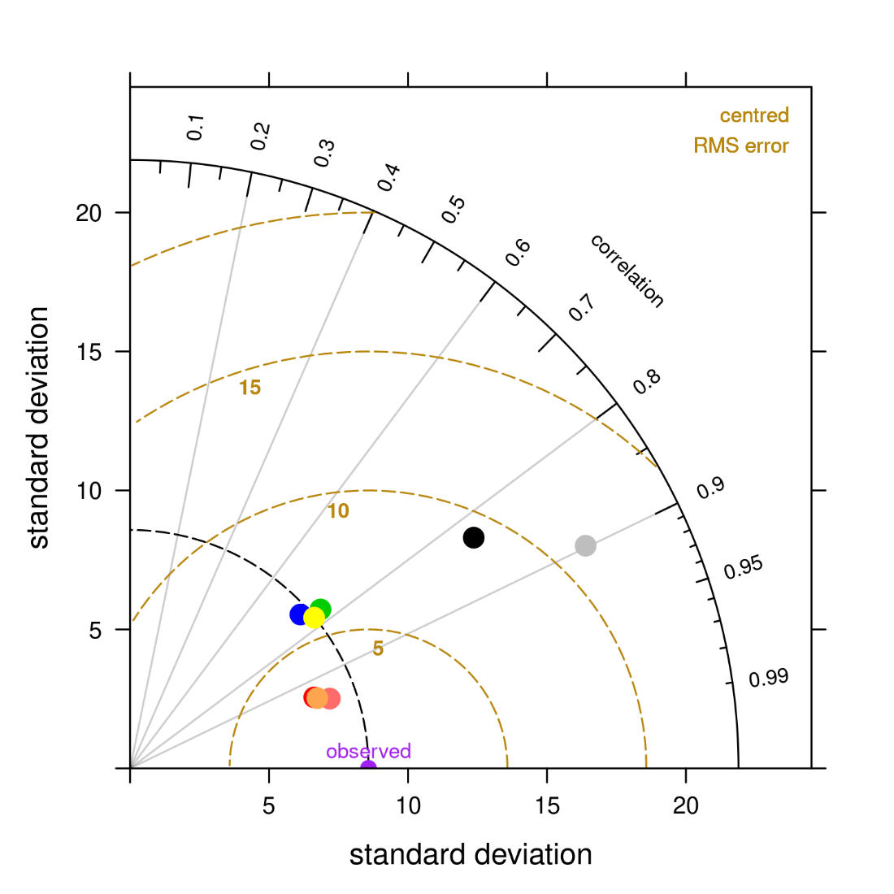
Taylor diagram at station location – Zoom in January 2021
STAX+GEFS performs best
Paris
Results from the ensemble are close (control, average and median)
January 21
The ensemble performs better than the deterministic run in this case
Taylor, K., 2001, Summarizing multiple aspects of model performance in a single diagram, JGR, 106, D7.
Maurer, C. et al., 2021, Evaluating the added value of multi-input atmospheric transport ensemble modeling for applications of the CTBTO, JER, 237, 106649.

Slide 10
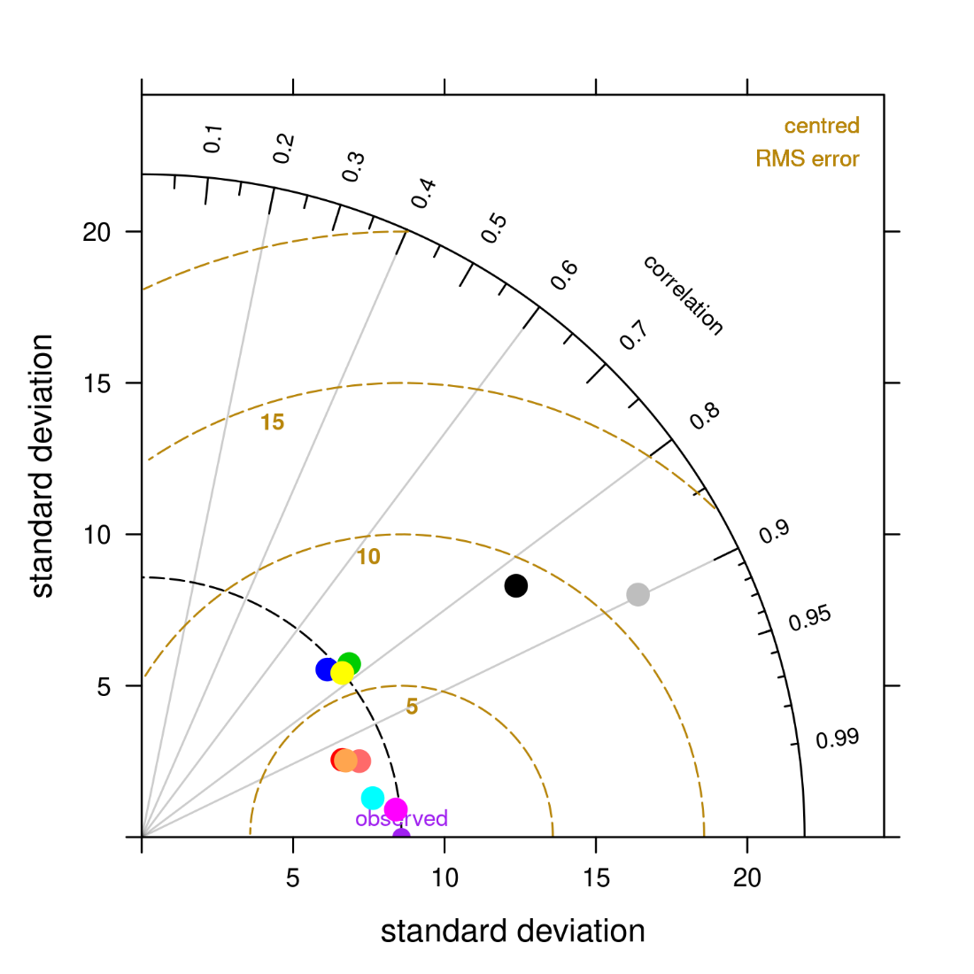
Taylor diagram at station location – Zoom in January 2021
STAX+GEFS performs best
Paris
Results from the ensemble are close (control, average and median)
January 21
The ensemble performs better than the deterministic run in this case
« GEFS Best » : A reconstructed series with, for each detection, the result of the closest perturbed member (not the same all along)
➔ The ensemble carries a valuable information (thanks to the range of the members)
Taylor, K., 2001, Summarizing multiple aspects of model performance in a single diagram, JGR, 106, D7.
Maurer, C. et al., 2021, Evaluating the added value of multi-input atmospheric transport ensemble modeling for applications of the CTBTO, JER, 237, 106649.

Slide 11
Taylor diagrams
Paris
January and June show different patterns
Nov 20 – June 21
“Full period”
Jan.21
The deterministic run performs better than the ensemble in June, and over the full period
The cost of the lower resolution of the ensemble members ?
Not yet enough statistics (longer period of comparisons would be needed)
June 21
However, overall “GEFS best” performs better
➔ The ensemble carries a valuable information thanks to its spread : one of the member is the closest to the measurements

Slide 12
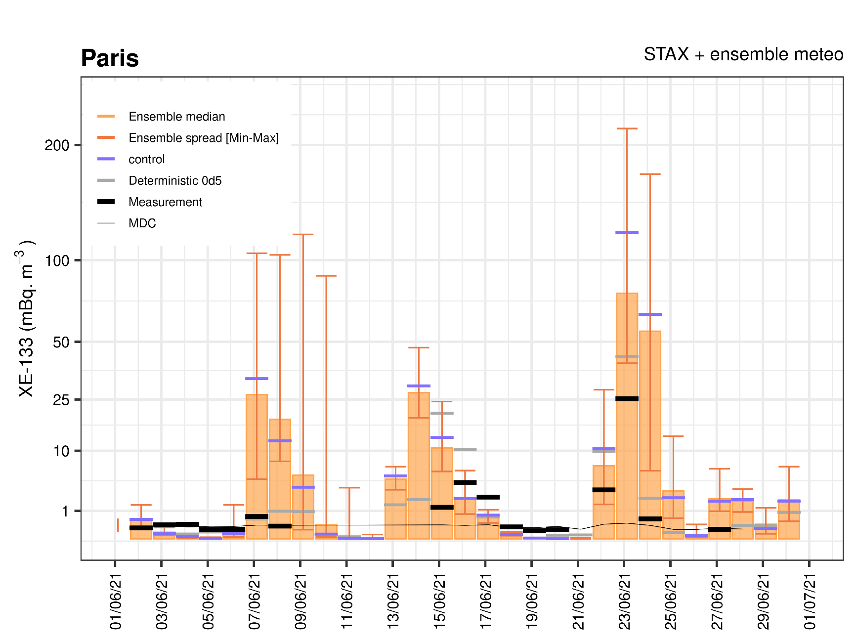
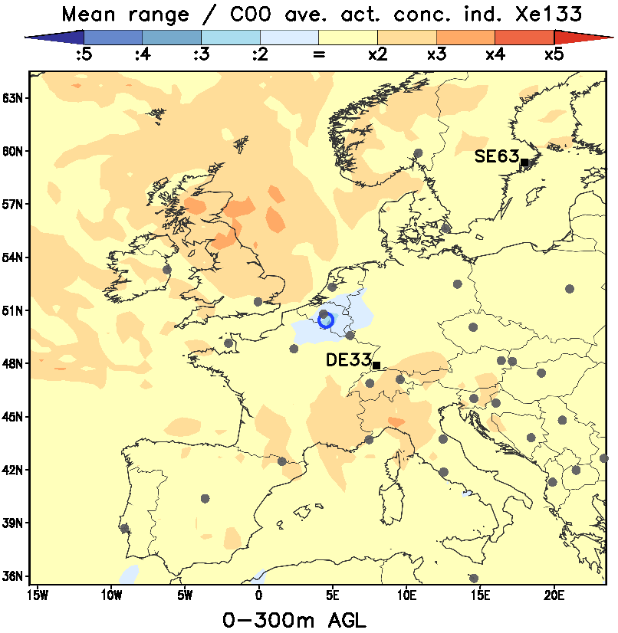
Time series at station location
Zoom in June 2021
In June, the range of the ensemble is covering up to > 100 mBq/m³
On average, over one year, the mean range / control ~ 2 x control result (-> map)
➔ The range of the ensemble (relatively to e.g. the control run) might carry an indication on a degree of confidence

Slide 13
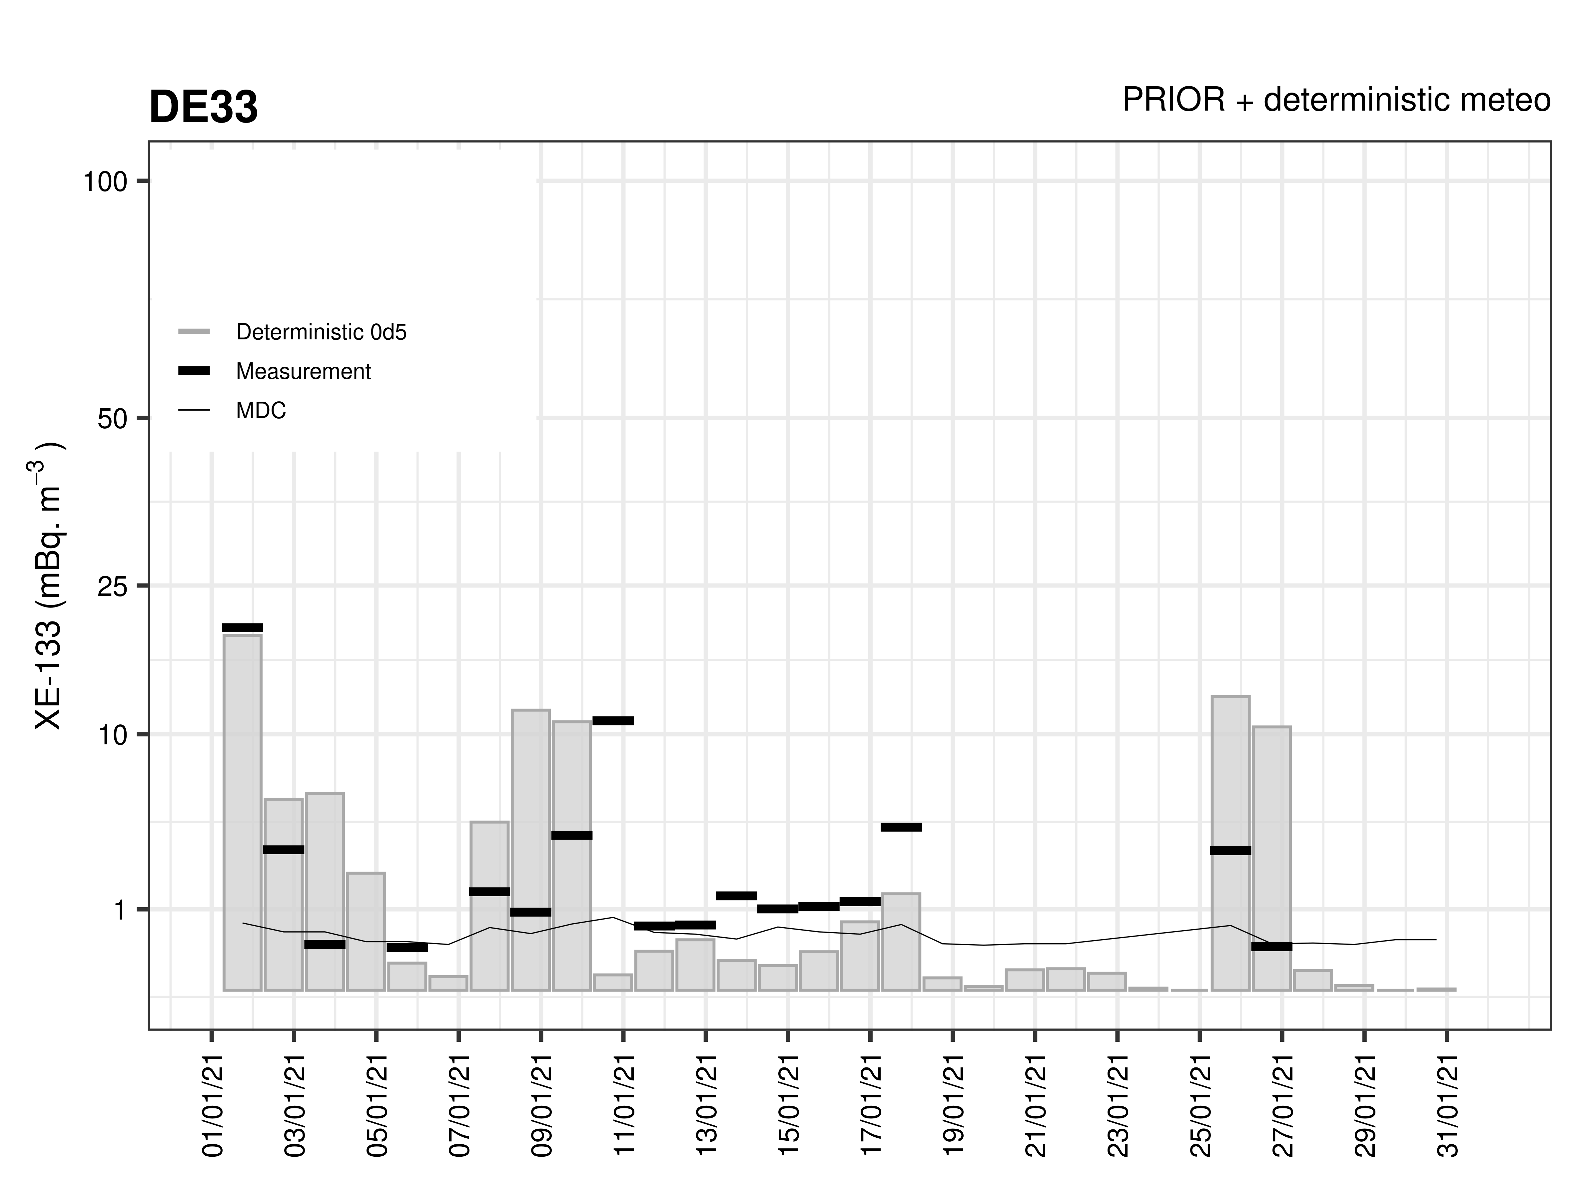
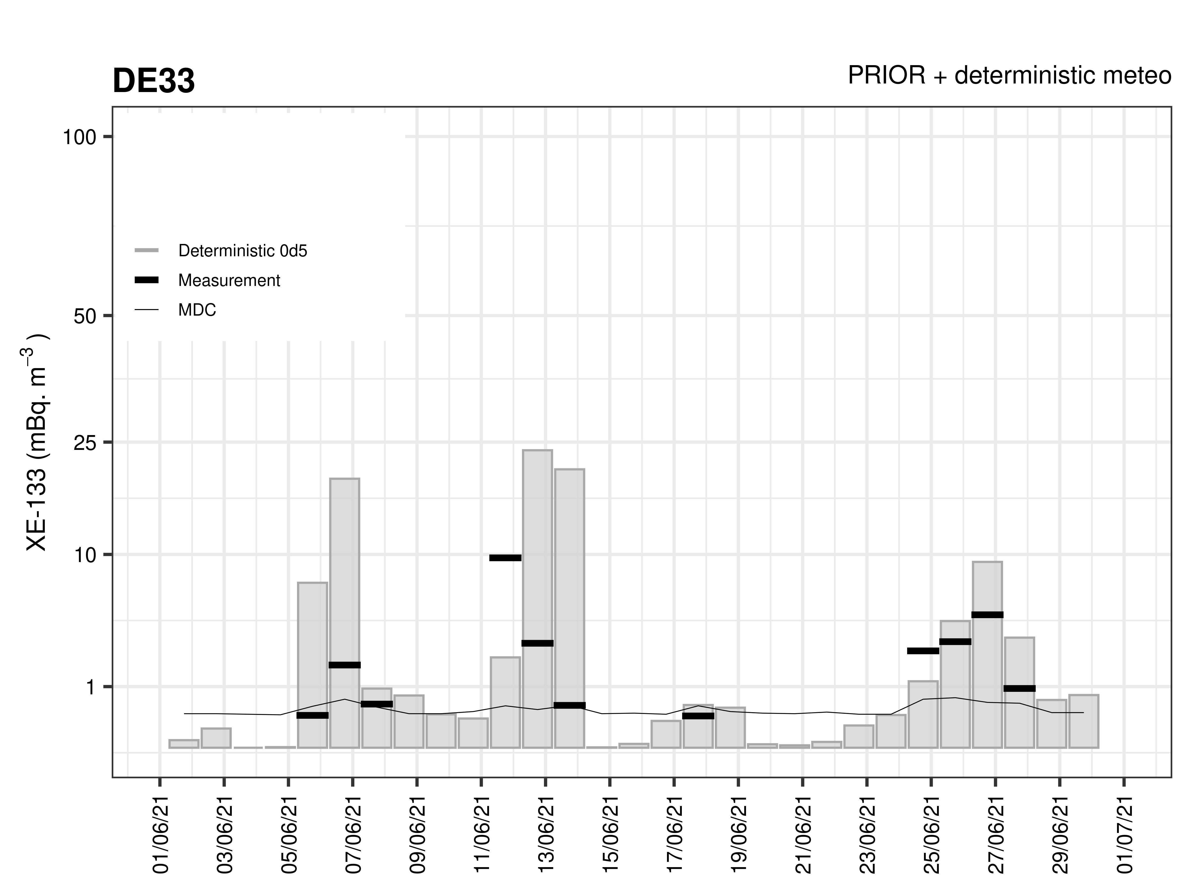
Time series at station location – Zoom in January and June 2021
January 21
June 21
FLEXPART v9.02
GFS / GEFS 0.5° / 6 hr
Output 0.5°x0.5 / 12 hr
CTL=1
24 hour average from 06h to 06h as measurements
Only emissions from IRE

Slide 14
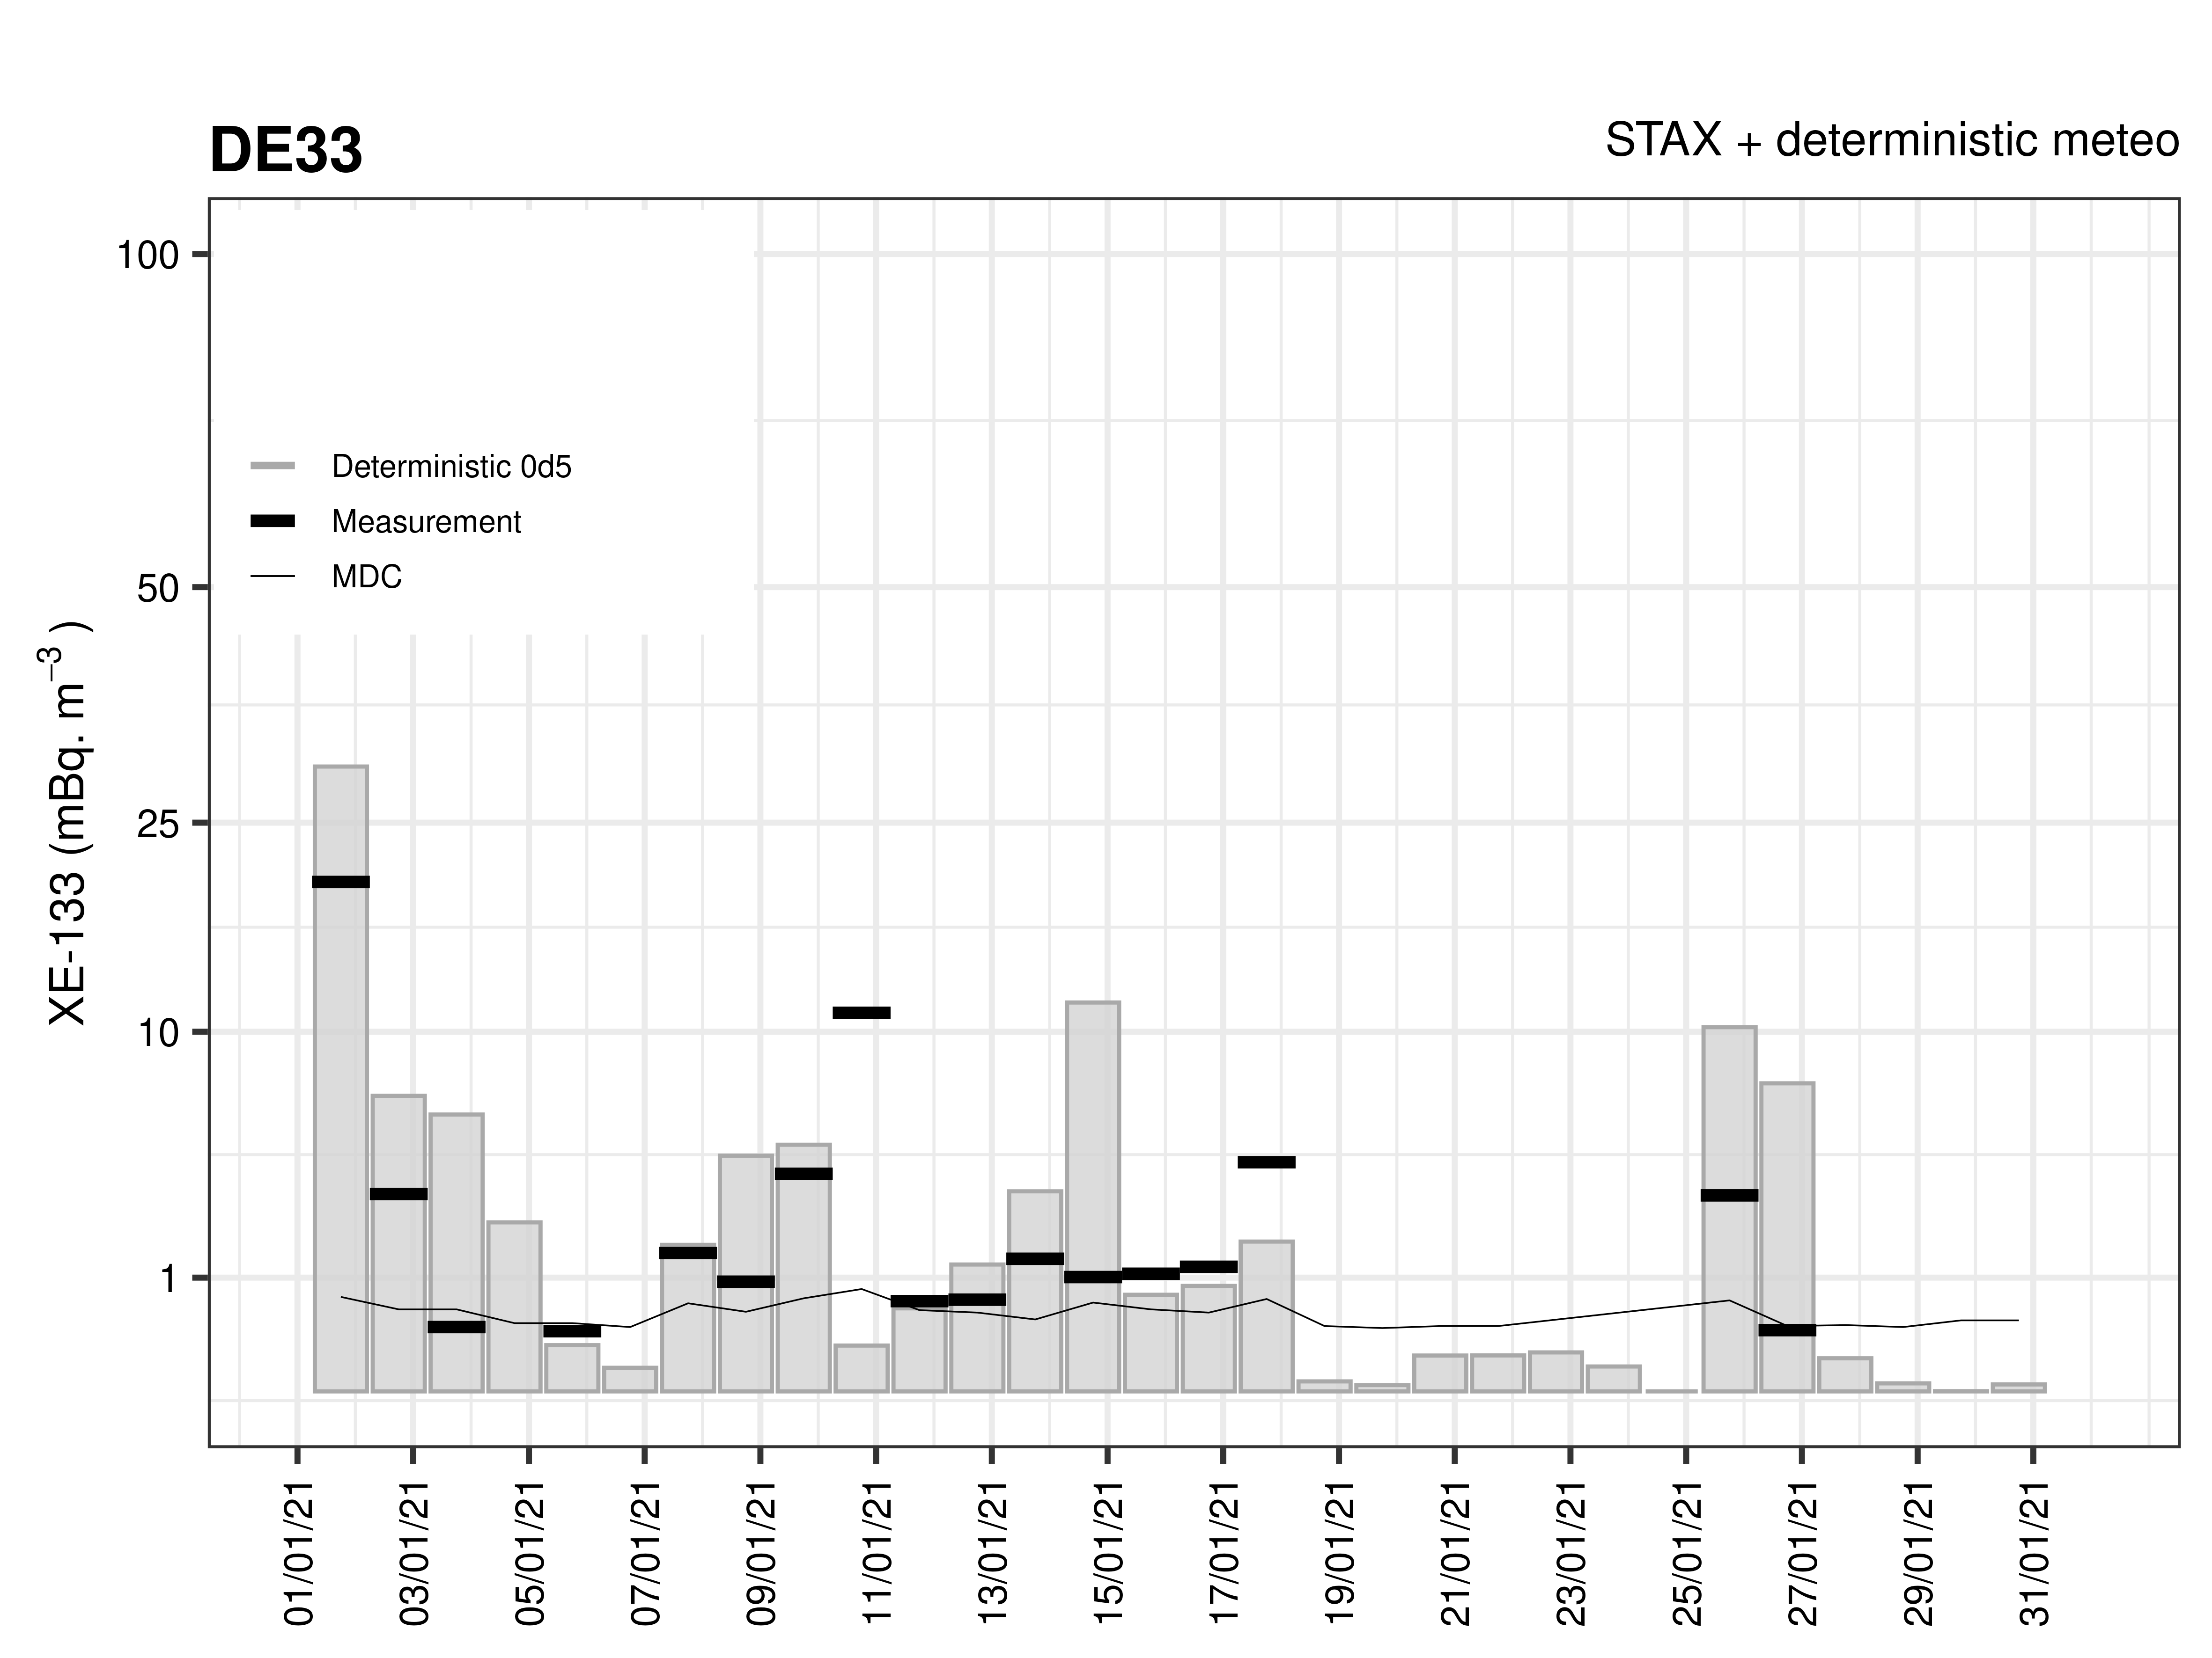
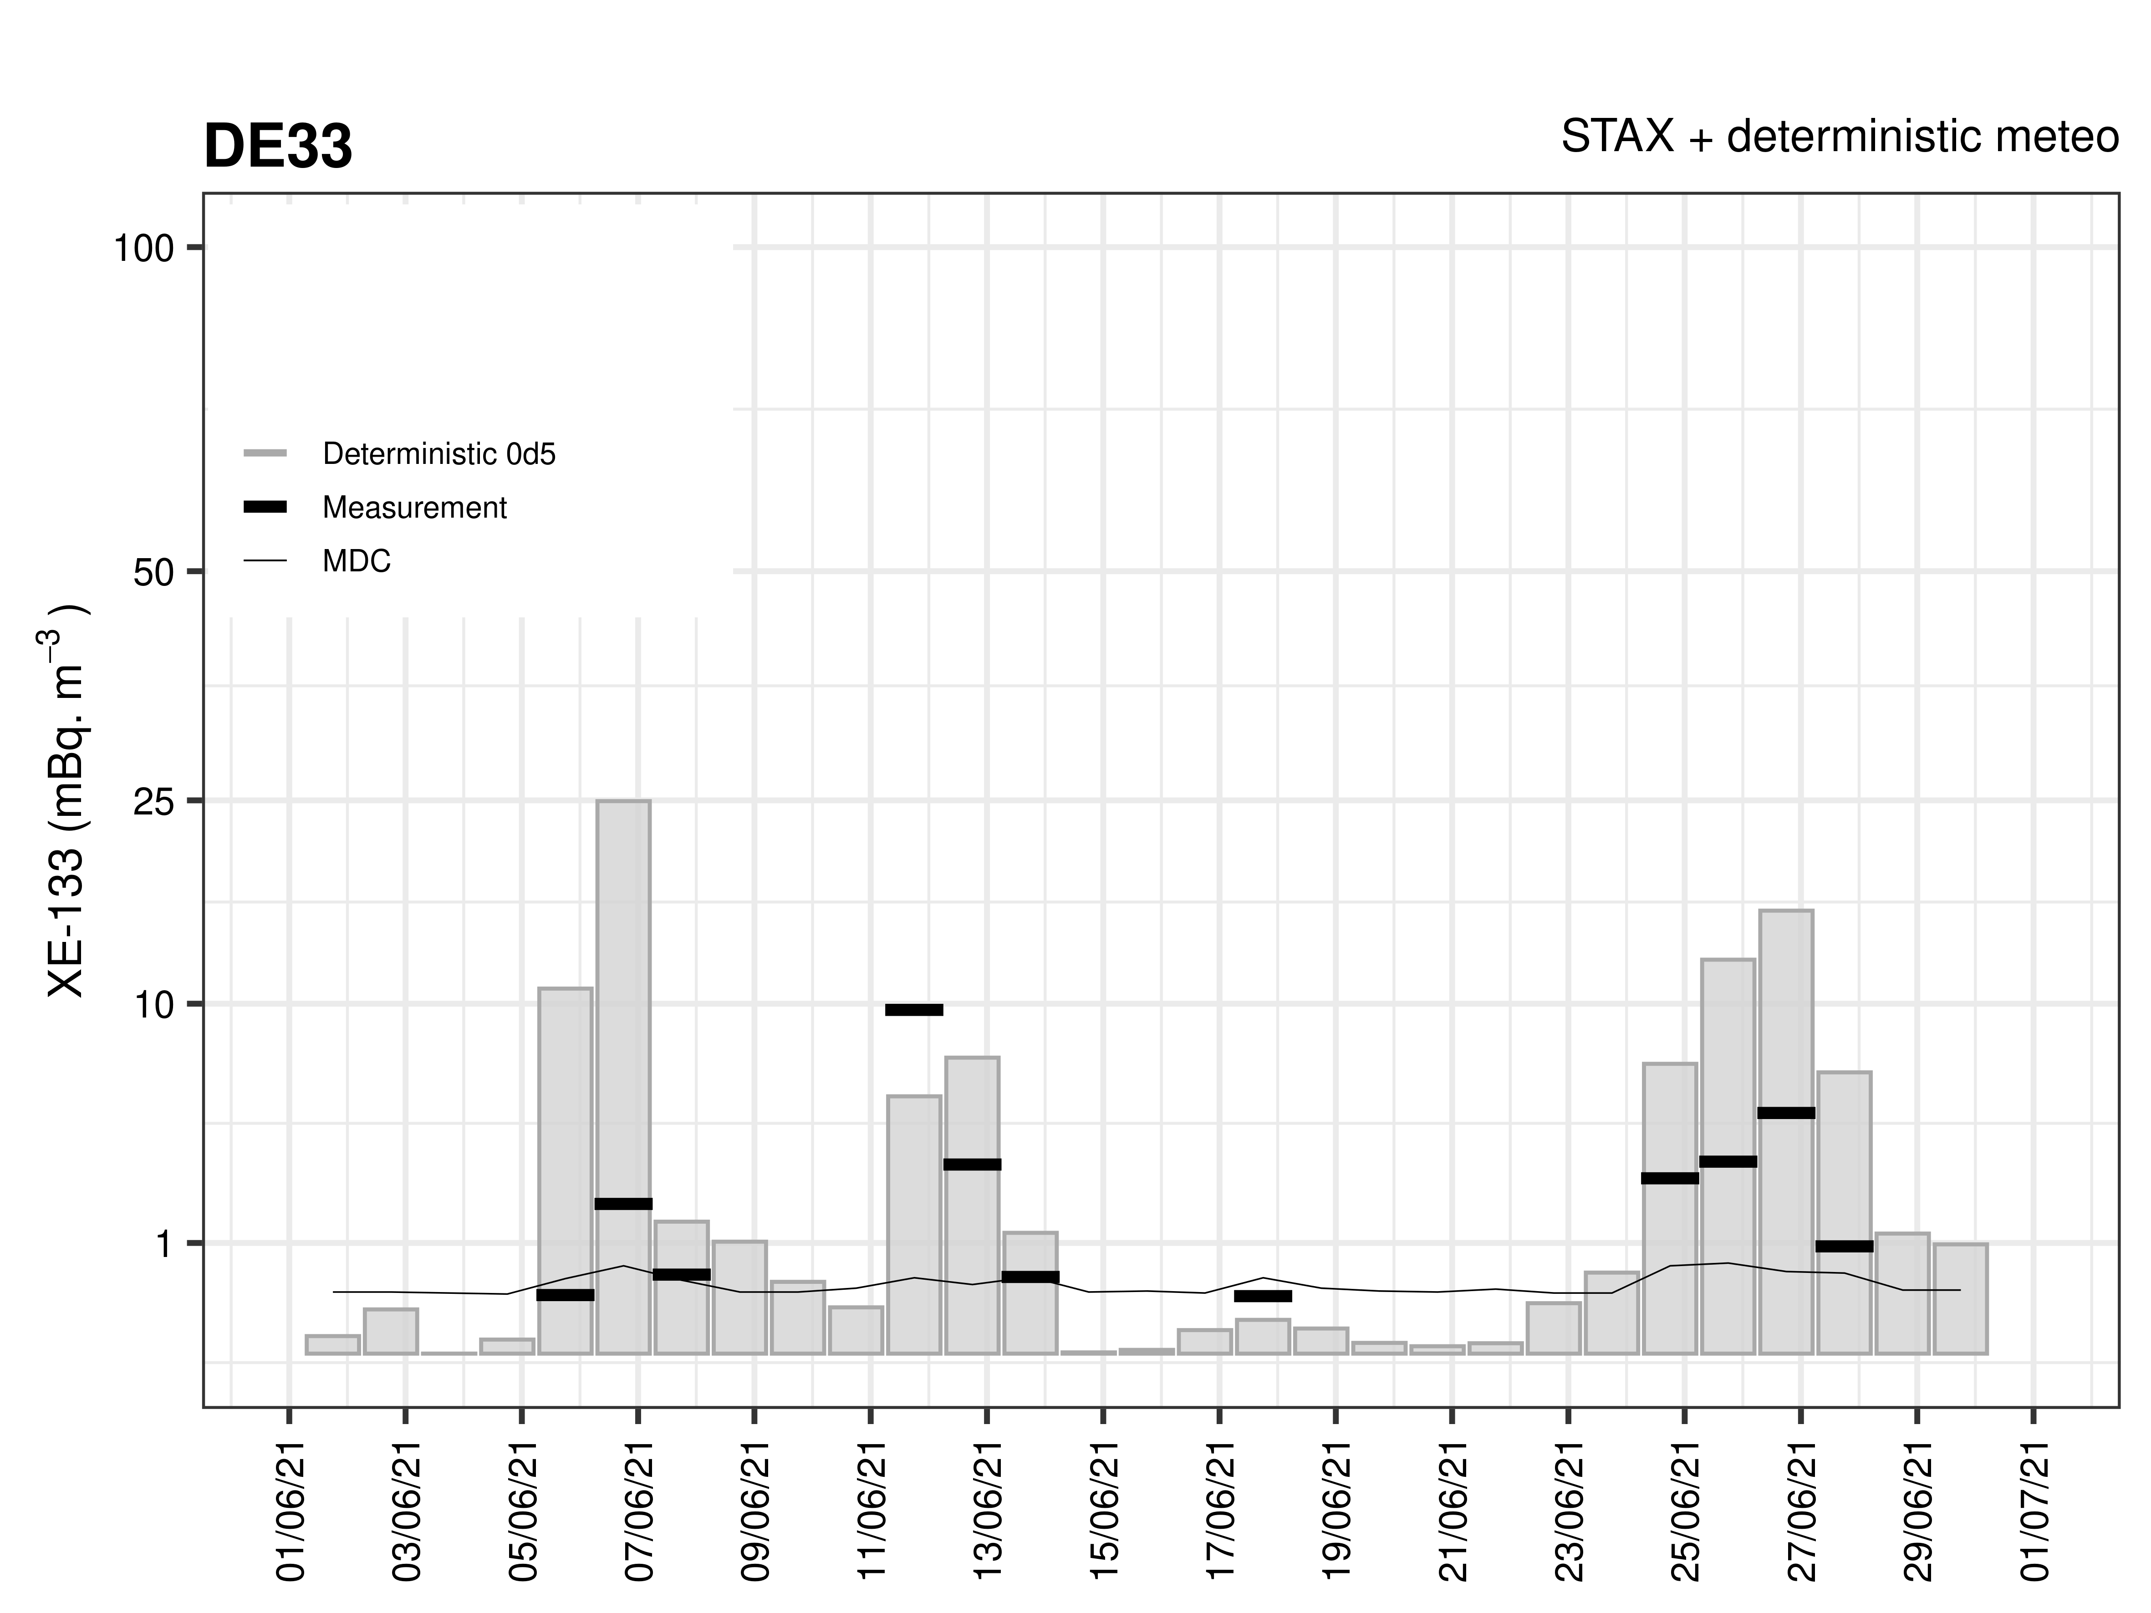
Time series at station location – Zoom in January and June 2021
January 21
June 21
Only emissions from IRE

Slide 15
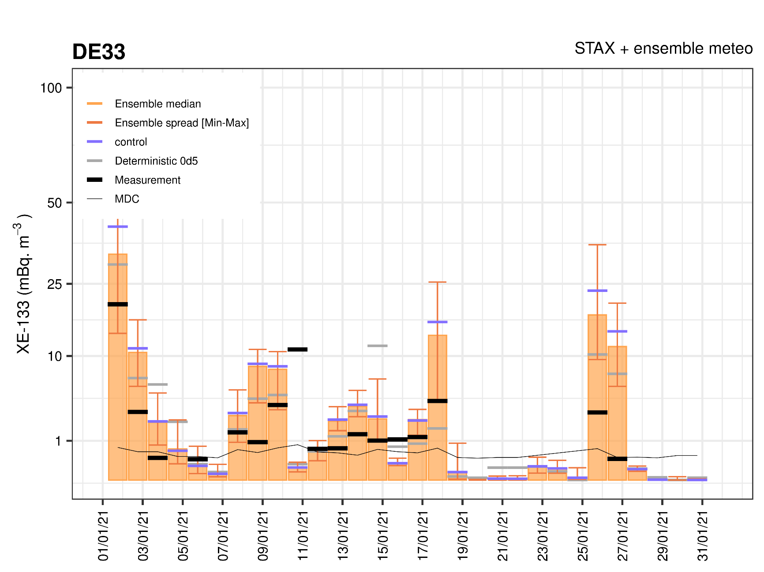
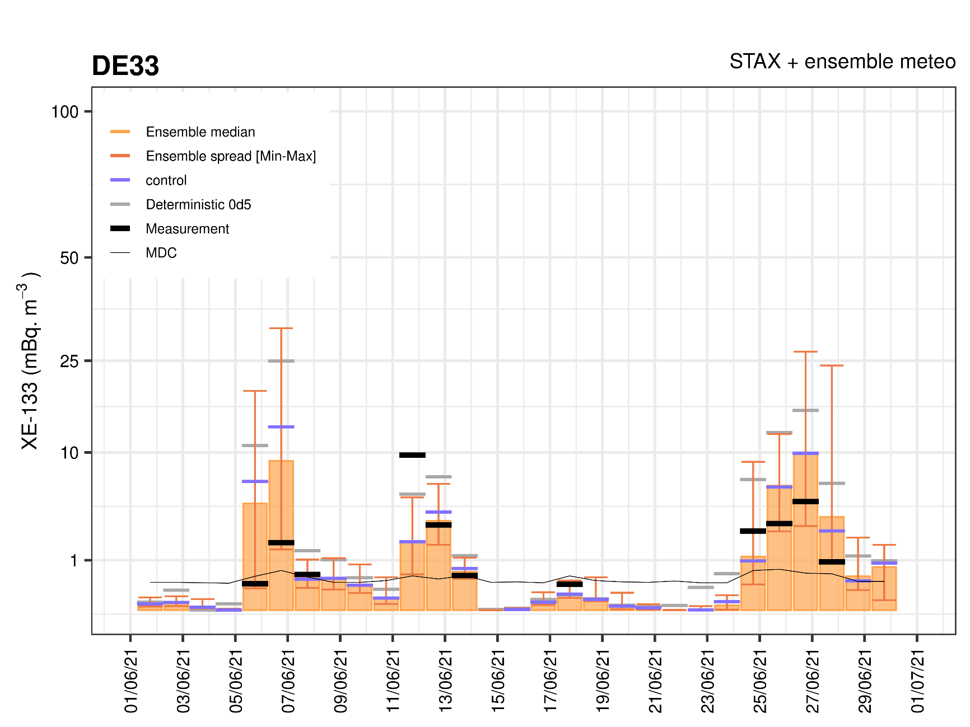
Time series at station location – Zoom in January and June 2021
Only emissions from IRE
January 21
June 21
►
►
►
►
►
►
►
►
►
►
►
►
►
Extreme outlier ensemble member can carry the best forecast
Some detection can still be out of the range of the ensemble (but still “not too far” from IRE)
1 detection = No ensemble member and not the deterministic predict a contribution from IRE > MDC => Backtracking to MIP in Russia ➔ The simulation correctly plays its part of flagging a detection from another source

Slide 16
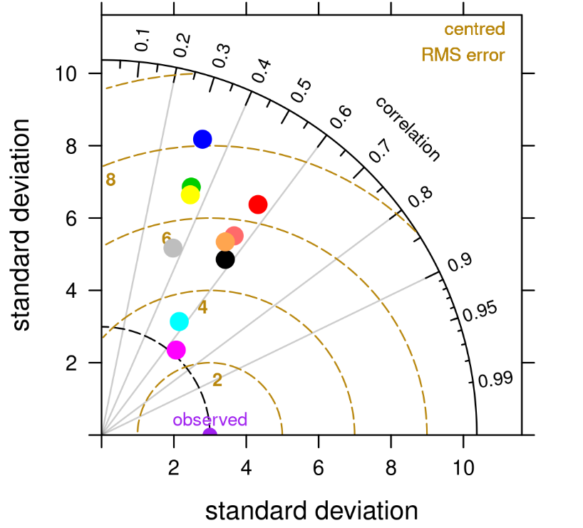
Taylor diagrams
DE33
Clearly the use of STAX + the GEFS ensemble improves simulations at DE33
Jan.21
Nov 20 – June 21
“Full period”
The control run is quite different than the deterministic run (worse in January and overall, better in June)
The ensemble (average and median) partly compensates for the loss of performance of the control compared to the deterministic run
June 21
“GEFS best” performs better than the rest
➔ The ensemble carries a valuable information thanks to its spread

Slide 17
Conclusions
A few feedbacks from the use of STAX data (from IRE, Fleurus) and NCEP ensemble meteorological data in ATM :
Clearly the use of STAX + the ensemble improves simulations at Paris and DE33 (250 and 400 km from Fleurus)
At this distance and in these cases, the ensemble (control, average and median) do not always performs better than the deterministic run (e.g., Paris)
However, overall the ensemble carries the best forecast through at least one of its member
Extreme outlier ensemble member can carry the best forecast => The valuable information lies in the average/median, but also in the spread and minimum/maximum of the members
In agreement, e.g., with De Meutter et al. [2016], Maurer et al. [2021], De Meutter and Delcloo [2022]
A few other feedbacks from daily operational analysis of simulation versus IMS data :
The day-to-day variability is not always captured by the simulations (even large peaks), even with the use of STAX and ensemble meteorological data ➔ day-to-day remains a challenge
Even with uncertainties and many challenges ahead to perfect the results, the simulation already plays its role to pointing to detections from other sources ➔ The analysis is consolidated as the data useful for interpretation are “piling up” (emissions, ensemble meteorological data)

Slide 18
Commissariat à l’énergie atomique et aux énergies alternatives - www.cea.fr

