Slide 1
Production and Abatement of Non-Traditional Xenon Isotopes at a Spallation Neutron Source
Michael Foxe, Theodore Bowyer,
Matthew Cooper, James Ely,
Paul Eslinger, James Hayes,
Michael Mayer, Justin McIntyre, Mark Panisko
PNNL-SA-XXXXX
Release Statement: Cleared for release.
Notes:
Stock image of cloud formations

Slide 2
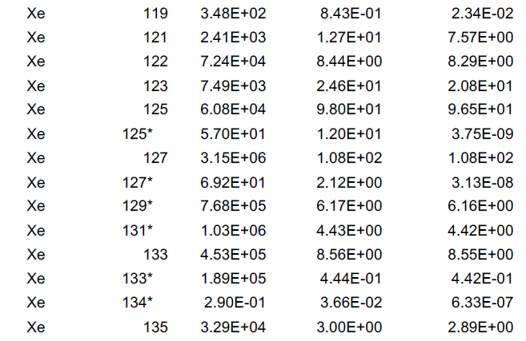
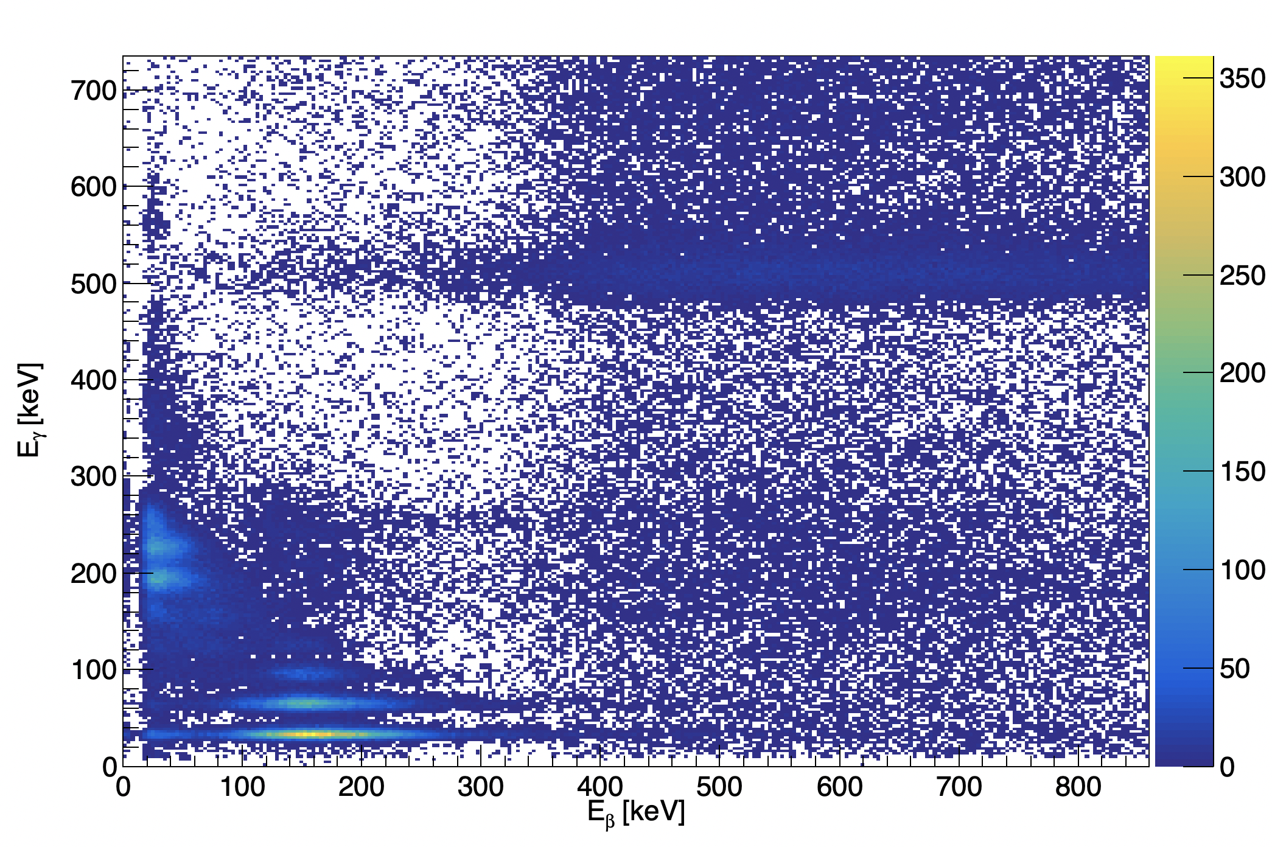
New Sources of Radioxenon
Anthropogenic sources of radioxenon are expanding
Current Nuclear Reactors
Medical Isotope Production
Accelerator Facilities
E.g., Spallation Neutron Source
Advanced Nuclear Reactors
E.g., Molten Salt Reactors
These new sources of radioxenon are also expanding the isotopes potentially detected at IMS stations

Slide 3
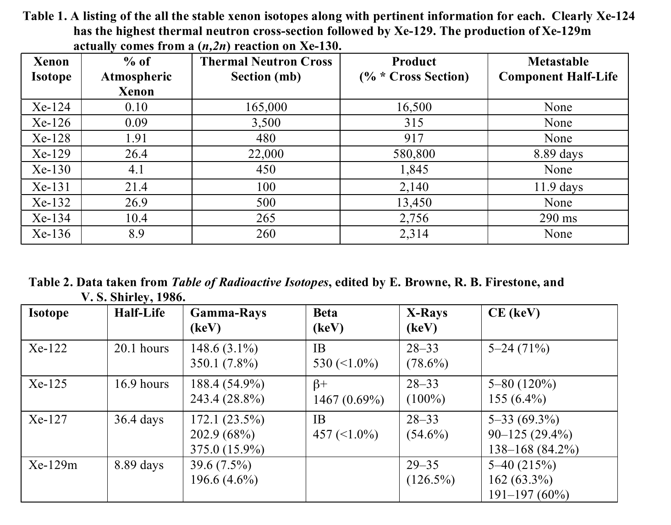
Non-traditional Xenon Isotopes
Many isotopes can be produced via neutron irradiation
¹²⁷Xe
¹²⁵Xe
^{129m}Xe
Neutron irradiation isotopes have been previously investigated and observed
¹²²Xe produced as medical isotope via proton or alpha bombardment
Not studied previously
McIntyre, Justin I et al.. 2008. “Generation of Radioxenon Isotopes.” In Proceedings of the 30th Seismic Research Review: Ground Based Nuclear Explosion Monitoring Technologies, 793–801.

Slide 4
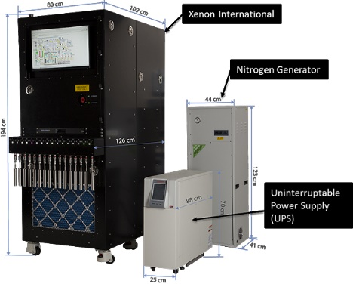
Xenon International
Next generation atmospheric radioxenon system
Faster and more sensitive than current generation systems
~2.5 cc of xenon in 6 hours
Compared to ~1 cc for SAUNA II in 12 hours
MDCs
<0.15 mBq/SCM for ¹³³Xe, ^{131m}Xe, ^{133m}Xe
<0.5 mBq/SCM for ¹³⁵Xe
Developed at PNNL
Transitioned to Teledyne Brown Engineering for production (Knoxville, TN)

Slide 5
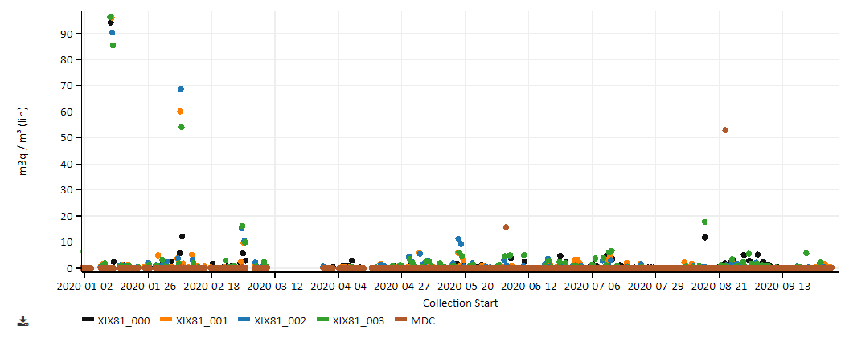
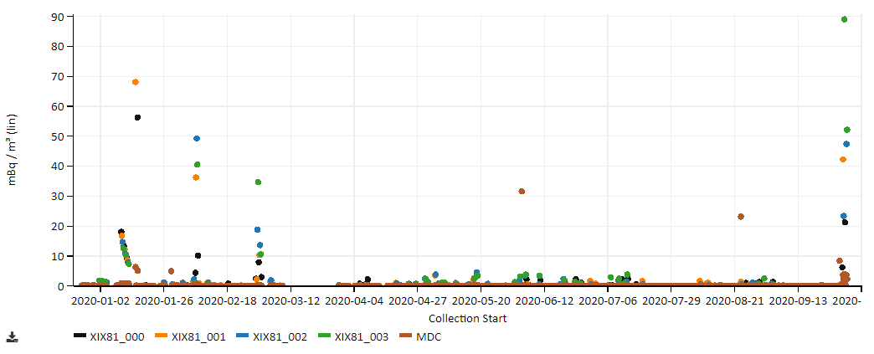
Puzzling Observations and Analyses - Measured at TBE in Knoxville, Tennessee
¹³³Xe
At initial glance, everything seems to be going well.
¹³³Xe – no unusual levels observed for the area
¹³⁵Xe – high but also not too unusual for the area
^{133m}Xe – unusual to have higher concentration than ¹³³Xe
^{131m}Xe – similar concentration to ^{133m}Xe
Further investigation showed that the gamma-ray spectrum has unusual features.
^{133m}Xe

Slide 6
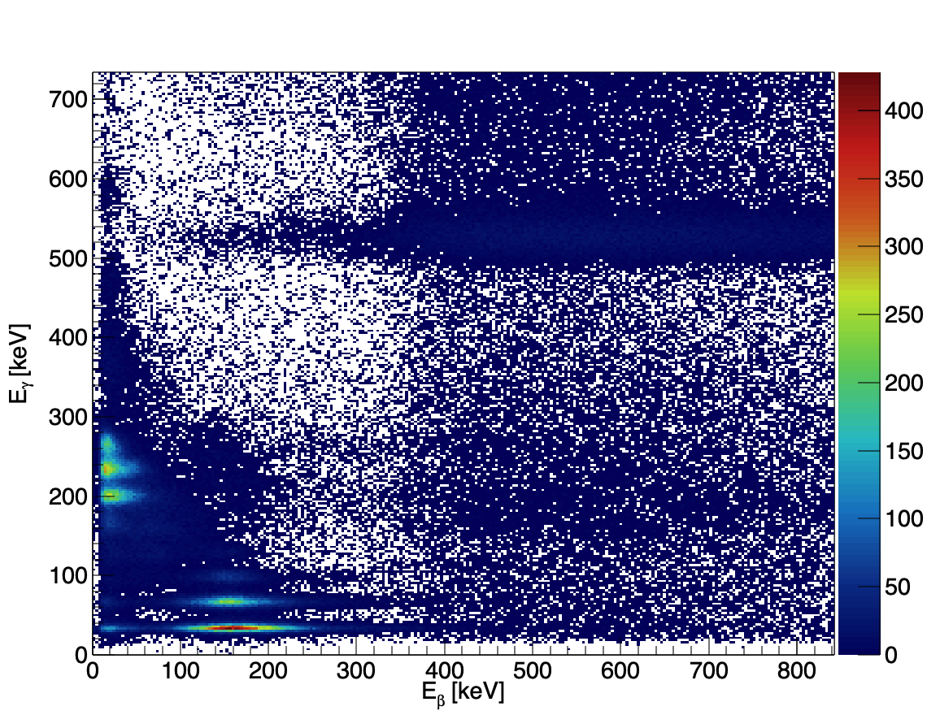
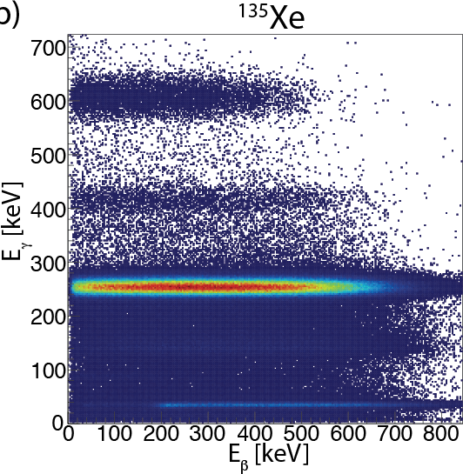
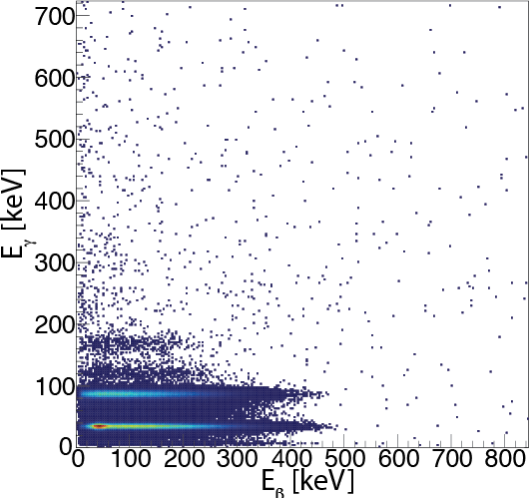
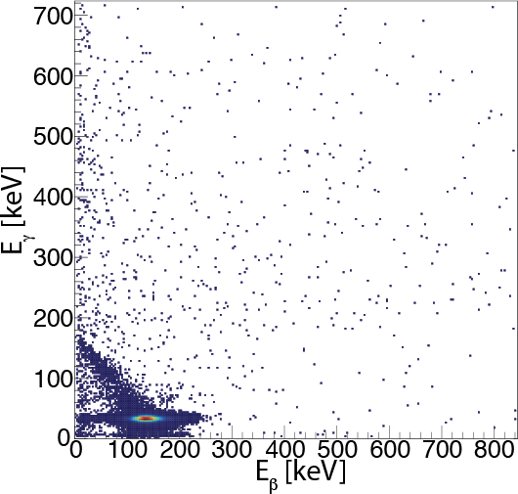
Atypical Coincidence Signatures - Measured at TBE in Knoxville, Tennessee
Spectrum observed on Xenon International
Typical Xenon Signatures
¹³⁵Xe
¹³³Xe
^{131m}Xe
^{133m}Xe/¹³³Xe

Slide 7
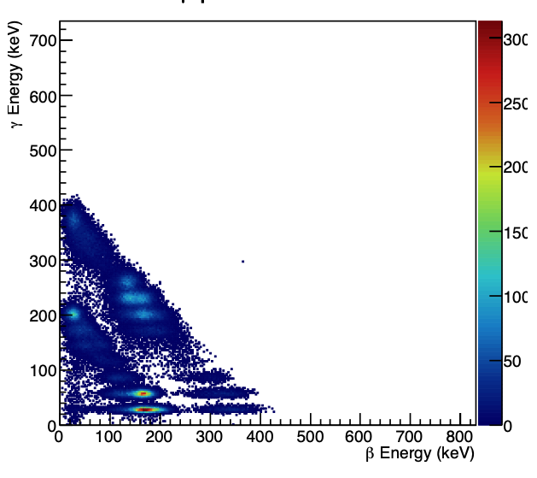
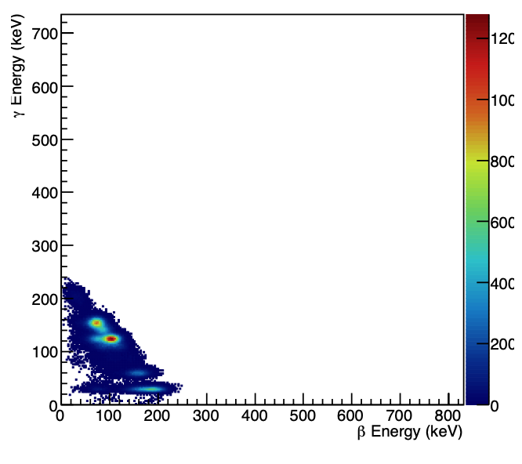
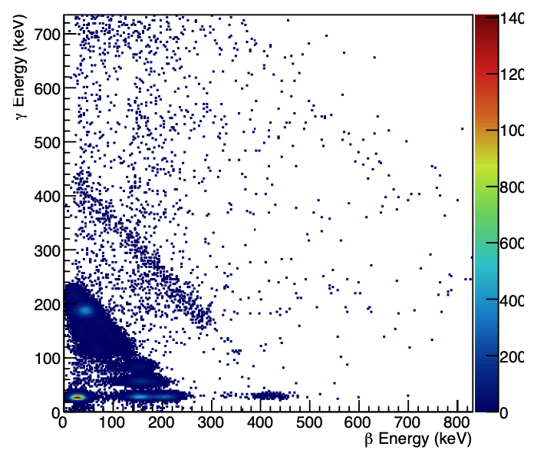
Monte Carlo Simulations
¹²⁷Xe Simulation
Monte Carlo simulations performed to observe clean signatures and extract efficiencies
Region at 511 keV in gamma energy not explained with these simulations
Xenon International Measurement
^{129m}Xe Simulation
¹²⁵Xe Simulation

Slide 8
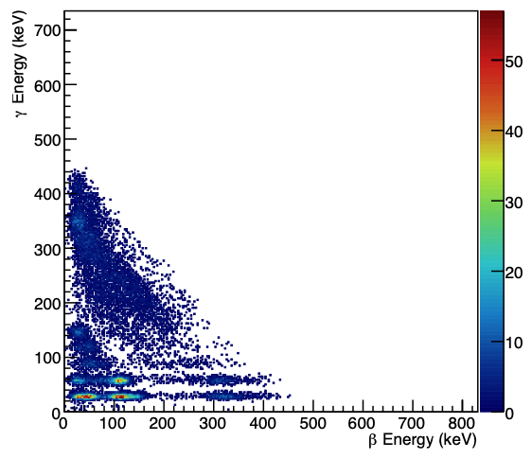
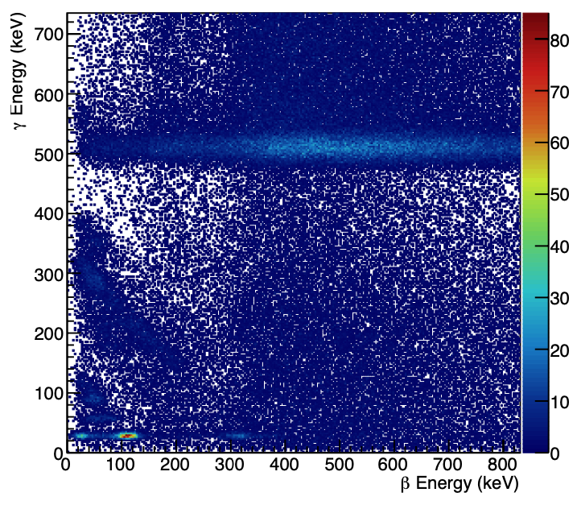
Missing Piece
¹²²Xe simulation alone did not seem to generate missing signature
Including daughter ¹²²I (T_{1/2}=3.63 minutes) produces missing signature
Only possible source of production of ¹²²Xe is via spallation in the mercury target at Spallation Neutron Source (SNS)
¹²²Xe Only Simulation
¹²²Xe Full Decay Chain Simulation

Slide 9
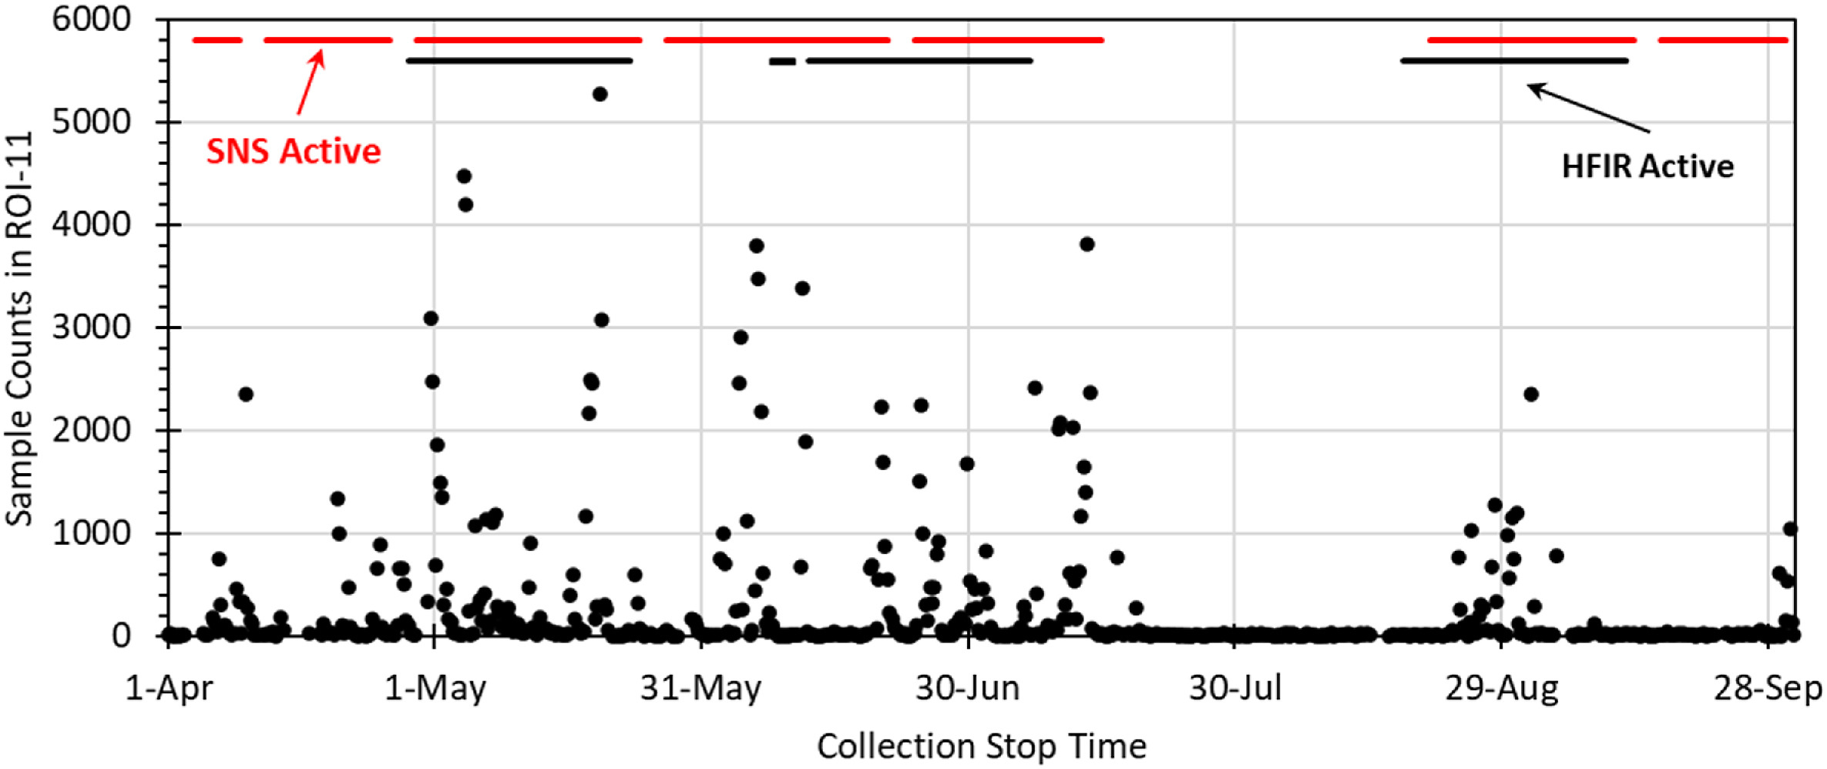
Correlation with SNS and HFIR Operation
Radioxenon Data from 2020 not Associated with Traditional Radioxenon Isotopes
Counts
Eslinger, Paul W. et al. 2022. “Determining the Source of Unusual Xenon Isotopes in Samples.” Journal of Environmental Radioactivity 247 (June): 106853. https://doi.org/10.1016/J.JENVRAD.2022.106853.

Slide 10
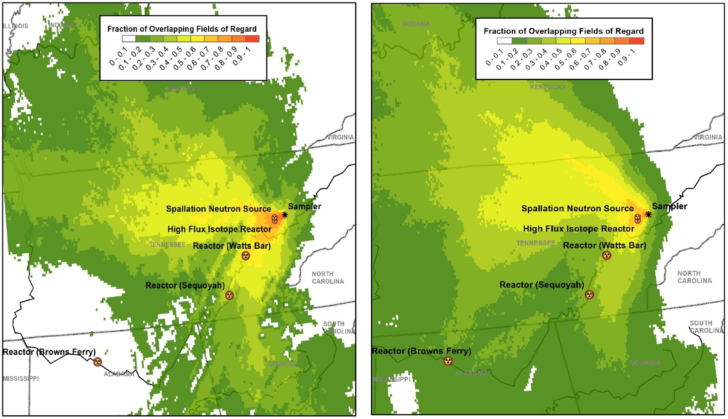
Atmospheric Transport Modeling (ATM)
ATM suggests that likely release is from HFIR or SNS
Wind patterns are not consistent with release from the nuclear power plants
Production mechanism suggests
SNS only
SNS and HFIR
Publication on ATM
Eslinger, Paul W. et al. 2022. “Determining the Source of Unusual Xenon Isotopes in Samples.” Journal of Environmental Radioactivity 247 (June): 106853. https://doi.org/10.1016/J.JENVRAD.2022.106853.

Slide 11
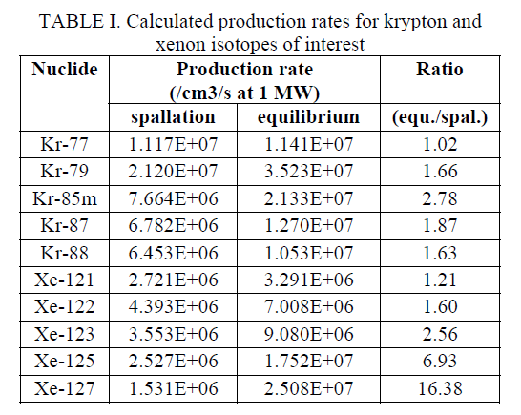
How is the Non-Traditional Radioxenon Produced?
Neutron bombardment of a liquid mercury target
Trace amounts of uranium within the target
Irradiation of natural xenon from air
Proton bombardment producing ¹²²Xe
DeVore, Joe R, Lu, Wei, and Schwahn, Scott O. 2013. "NOBLE GAS PRODUCTION FROM MERCURY SPALLATION AT SNS". United States

Slide 12
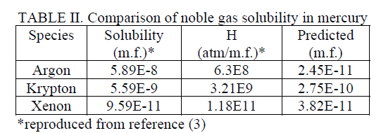
How is the radioxenon abated?
How much gets out of the target?
Target material: liquid mercury
Other sources use different target materials
What traps do the gases go through before being released?
Helium off gases and purge for studying the production rates
HEPA filters for particulate
Cryogenic sulfur-impregnated charcoal absorber
How long is the xenon contained before being released?
Initial retention time of approximately 350 minutes (1/3 ¹²²Xe half-life)
DeVore, Joe R, Lu, Wei, and Schwahn, Scott O. 2013. "NOBLE GAS PRODUCTION FROM MERCURY SPALLATION AT SNS". United States

Slide 13
Other possible sources around the world
Neutron Activation Sources
Accelerators
Reactor cover gas
Cover gas hold-up times impact the short-lived isotope interferences
Spallation sources
SNS (this presentation)
Los Alamos Neutron Science Center
ISIS neutron source in the UK
Japan Proton Accelerator Research Complex (J-PARC) in Japan
European Spallation Source in Sweden
China Spallation Neutron Source
Are there other commercial sources of these isotopes?

Slide 14
Conclusion and Outlook
Newly observed isotopes seen near HFIR and SNS suggest new source of interfering xenon background (non-traditional production mechanisms)
New isotopes interfere with all traditional ROIs used for activity calculations
Algorithms will continue to calculate normally
Concentrations and ratios will not make sense
Non-traditional xenon isotopes are produced through a series of mechanisms
Spallation on mercury targets
Air activation
Fission isotopes
Even with wind predominantly in the other direction, they can still be detected at near-by stations
These non-traditional isotopes may be produced at other facilities around the world

