Slide 1
Radioxenon measurements at the Shelter Object in the new Safe Containment at Chernobyl Nuclear Power Plant
Anders Ringbom, Mattias Aldener, Tomas Fritioff, Johan Kastlander
Swedish Defence Research Agency (FOI), Stockholm, Sweden
Peter Andersson
Uppsala University, Uppsala, Sweden
Maxim Saveliev, Olexandr Kalynovsky, Pavel Sabenin
Institute for Safety Problems of Nuclear Power Plants (ISP NPP), Ukraine

Slide 2
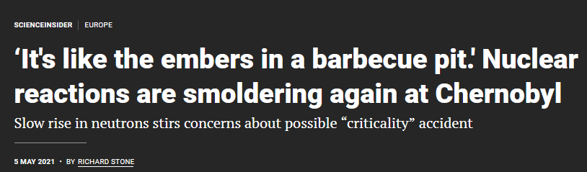
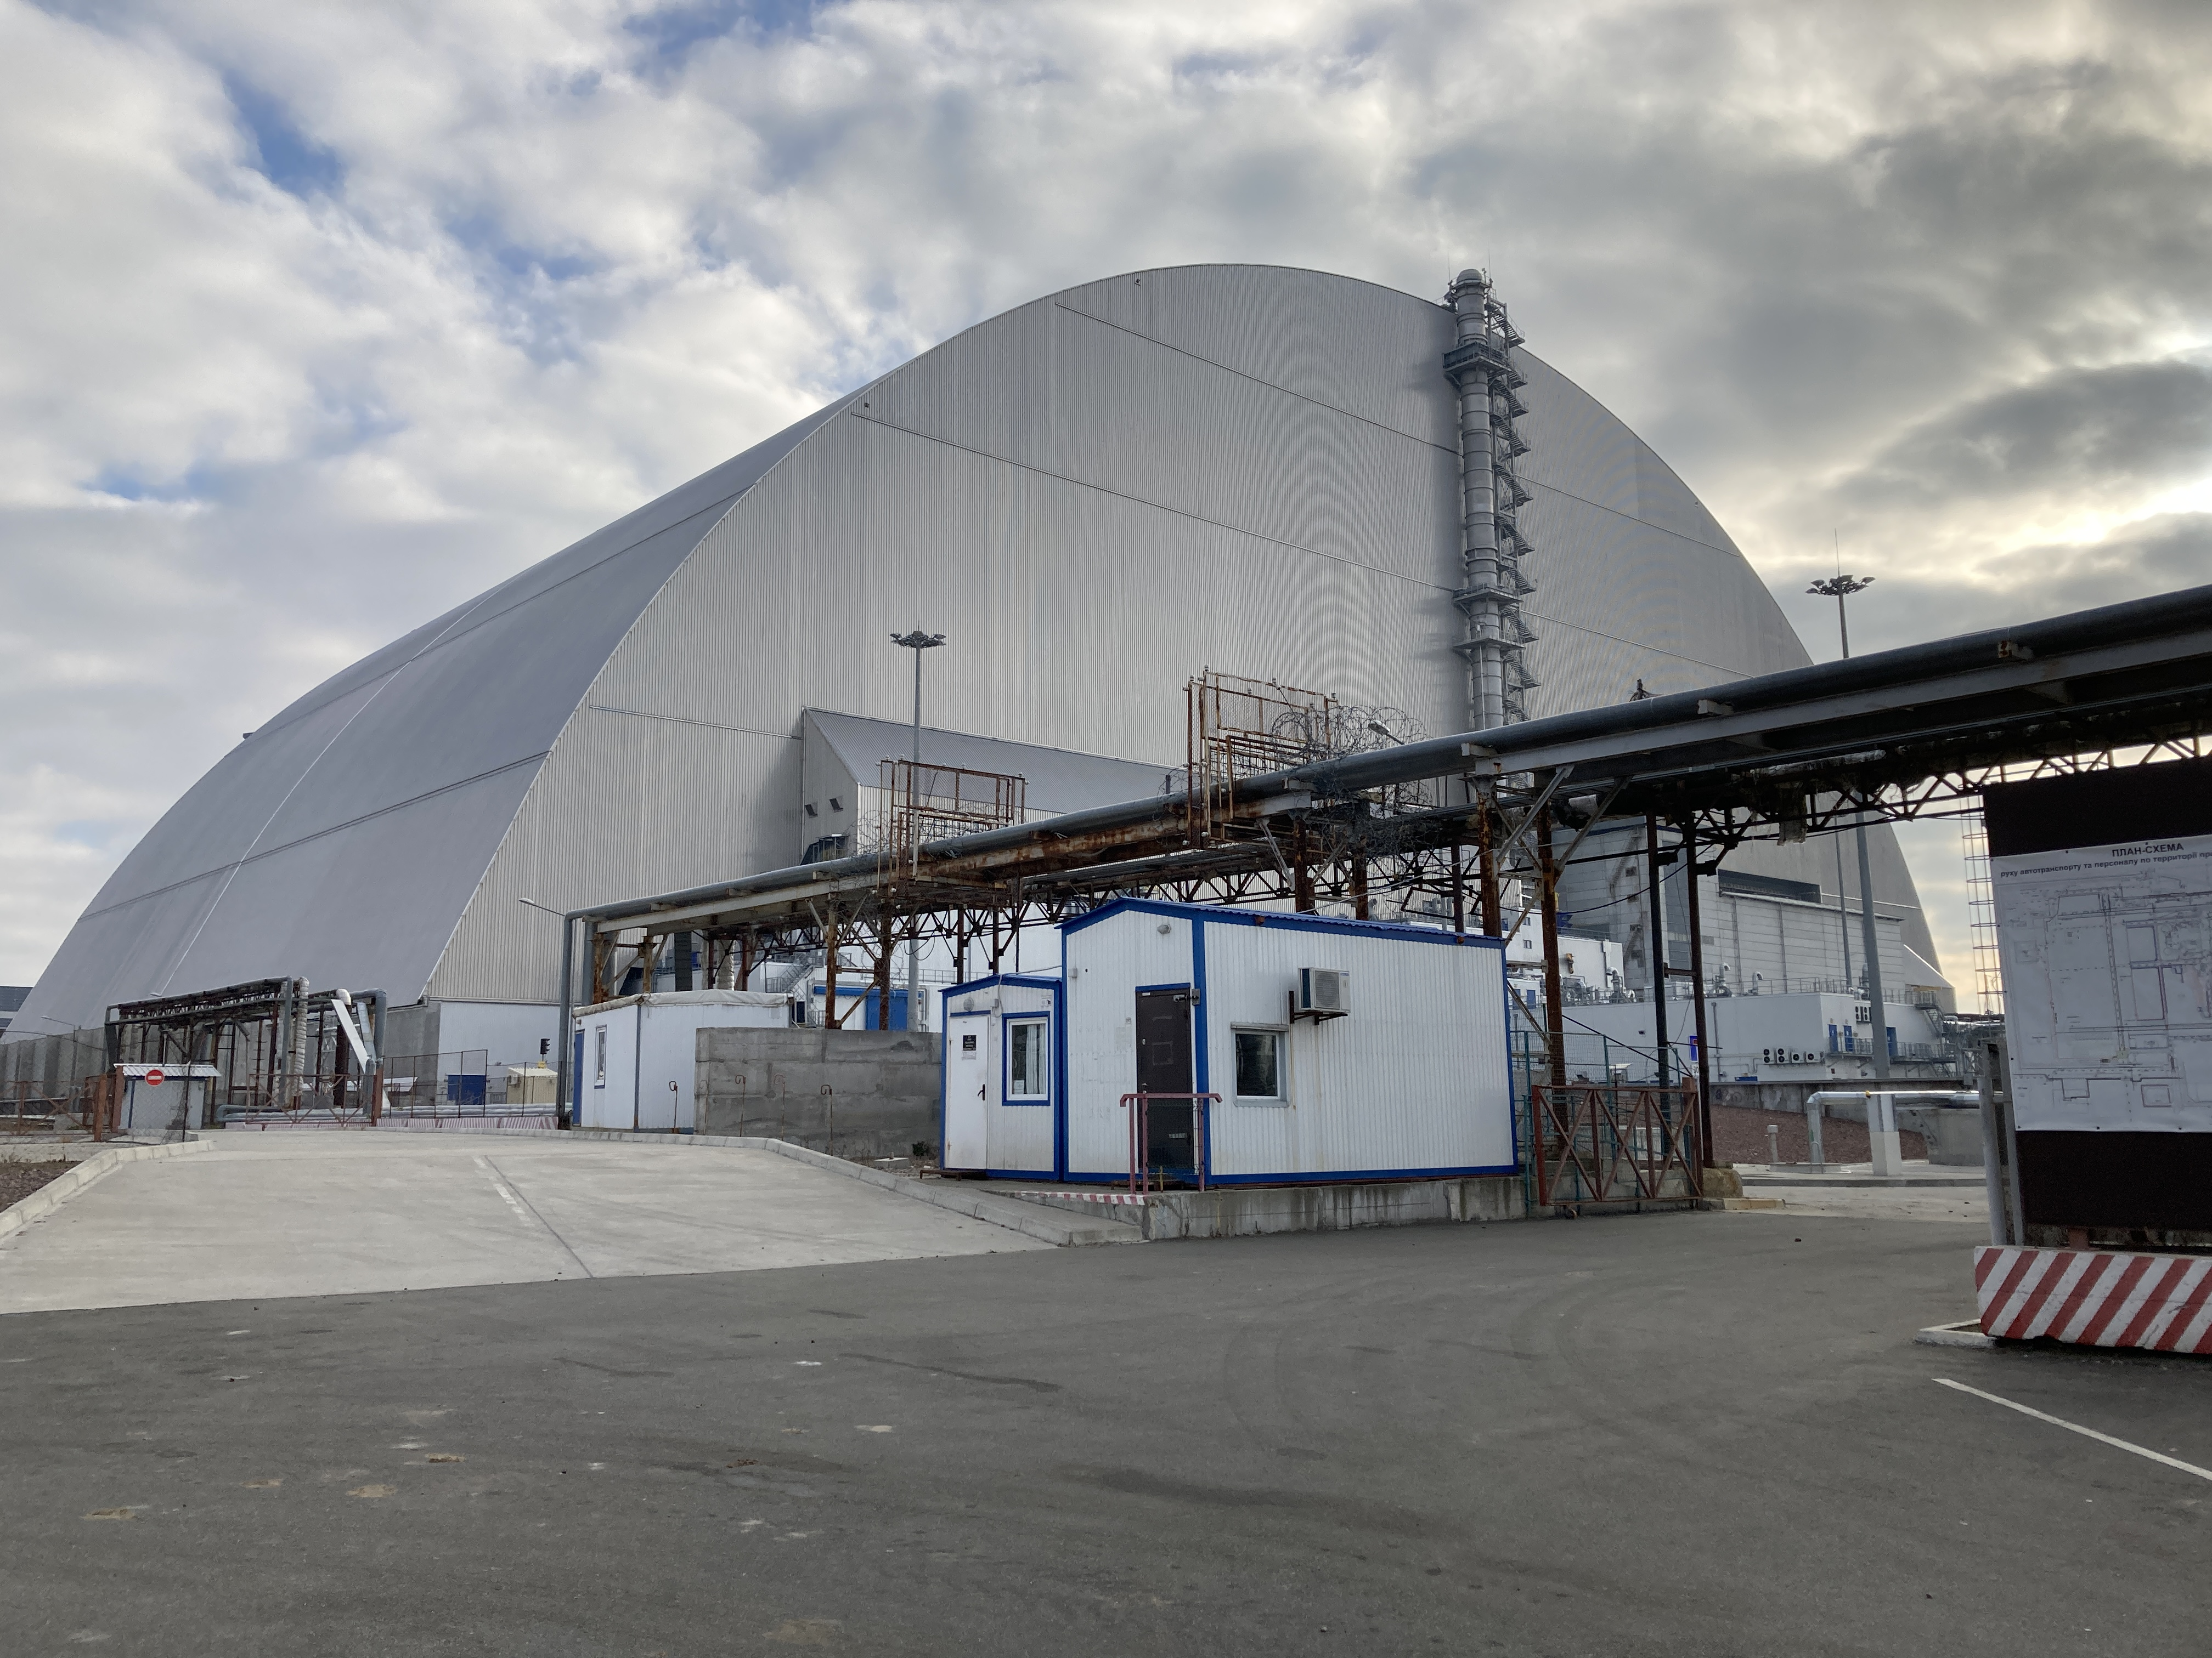
Outline
Science, May 5, 2021:
Background
Criticality risks at the Shelter Object
Radioxenon measurements as a diagnostic tool for fission activity in the FCM
Modelling xenon production and release
Initial measurements
Conclusions and outlook

Slide 3
Background
About 96% (190 tons) of the Nuclear Material present in reactor 4 prior to the accident on April 26, 1986, still remains in the reactor building, in the form of Fuel Containing Material (FCM).
In 2019, the New Safe Containment (NSC) was completed, protecting the Shelter Object (SO), which was constructed directly after the accident.
The FCM constitution and geometry is partly unknown, and it is therefore important to consider the possibility of local configurations with high reactivity.
Instrumentation for criticality assessment are of importance for the overall safety of the facility.
Pictures:
Krasnov V.O. et al. (2016) ”Object Shelter: 30 years after the accident”. Ukrainian National
Academy of Sciences, Institute of NPP Safety Problems, Chernobyl, Kiev region, 512 p., 2016

Slide 4
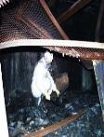
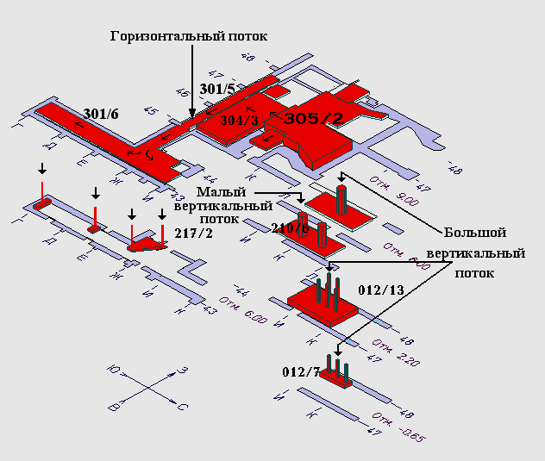
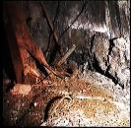

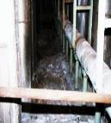
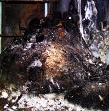


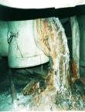
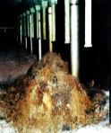


Background
(a)
(d)
About 75 tons of molten and
solidified material present in
sub-reactor room 305/2.
(а)
About 20 ton of fuel melted partly through the concrete bottom slab of the reactor vault.
Studies show that certain uranium-water (created by flooding) or uranium graphite compositions (created by collapse) can allow for self-sustained fission reactions in such clusters.
(b)
(c)
(f)

Slide 5
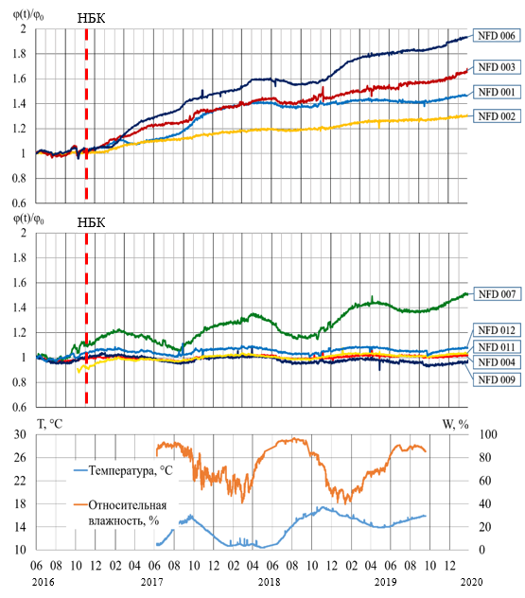
Neutron monitoring in the SO
Neutron monitoring is performed in the SO using 19 distributed units.
The detectors are several meters from the FCM, with relatively unknown type and amount of material in-between.
Two neutron incidents were recorded in 1992 and 1996, showing initial increase followed by oscillations. No definite conclusion on the cause of these events has been reached.
Except for the two events in 1992 and 1996, the neutron flux was stable and predictable, with a periodical seasonal nature, due to moisture variations.
After the NSC was installed, a steady increase has been observed.

Slide 6
Radioxenon measurements in the NSC
The possibility of a future criticality incident cannot be excluded.
Such an event will most likely not result in increased contamination outside the NSC, but constitutes a safety risk to the for the staff working at the facility.
Any measurement method that can provide further information on the state of the FCM in the reactor rooms is therefore relevant.
Radioxenon measurements inside the NSC has the potential to achieve this, and a project has therefore been initiated.

Slide 7
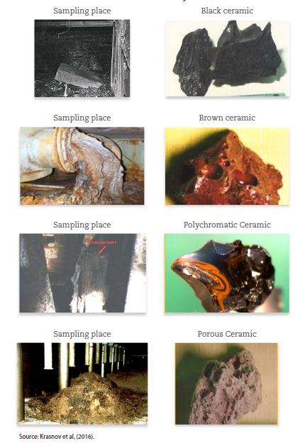
Radioxenon measurements as a diagnostic tool for fission activity.
Radioxenon is an unique fission signature.
The structure of the FCM has became very porous with time, due to chemical reactions and decay fragments. This increases the possibility for xenon created in fission to escape the material.
Air sampling and measurement is a non-intrusive and safe measurement technique, and could be performed continuously using existing technique developed for nuclear explosion monitoring.
Source: Long-Term Management and Actions for a Severe Accident in a Nuclear Power Plant, NEA – 7506, 2021

Slide 8
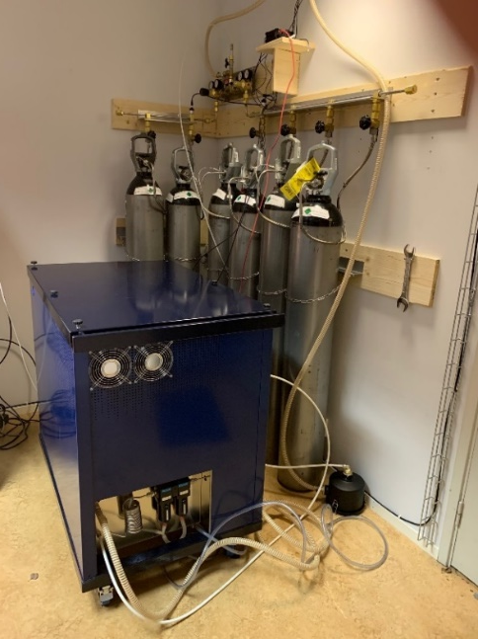
A three-step project
Initial air sample collection and measurement using simple equipment developed for the purpose.
Continuous measurements using a Q_{B} – system for a longer period.
If the results show that the method works: Installation of a permanent radioxenon monitoring system at the NSC.

Slide 9
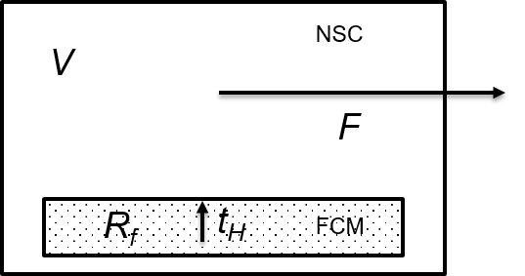
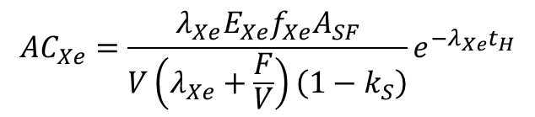




Estimating radioxenon production and release from the FCM – a first indication using a static model
FCM is a neutron source due to spontaneous fission and alpha decay causing (α,n) – reactions.
It is also a sub-critical reactor, where the induced fission can cause additional neutrons and fission gas.
We modify a model used by PNNL* when studying radioxenon in a waste storage tank to account for induced fission and xenon emanation. The activity concentration in the NSC volume can then be expressed as:
Emanation coefficient
Cumulative fiss. yield
SF activity
$$V:NSC volume$$
$${AC}_{Xe}=\frac{λ_{Xe}E_{Xe}f_{Xe}A_{SF}}{V\left(λ_{Xe}+\frac{F}{V}\right)\left(1−k_{S}\right)}e^{{−λ}_{Xe}t_{H}}$$
$$R_{f}:Total fission rate$$
$$F:Ventilation flow$$
$$t_{H}:holdup time$$
Subcritical effective multiplication
factor.
* Bowyer, T.W., et al., Estimation of Plutonium-240 Mass in Waste Tanks Using Ultra-Sensitive Detection of Radioactive Xenon Isotopes from Spontaneous Fission, PNNL report 26495, May 2017. https://doi.org/10.2172/1413393

Slide 10
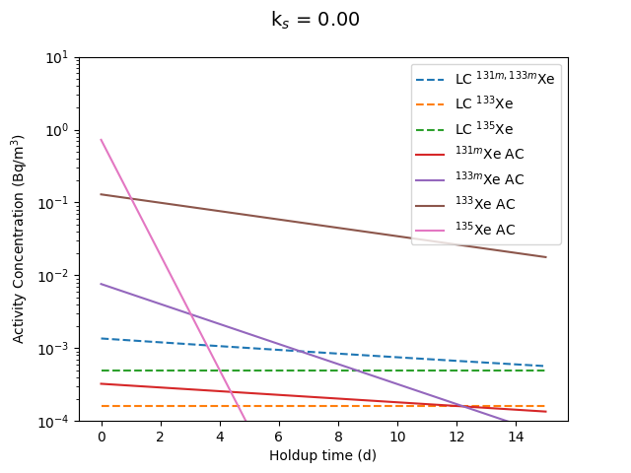
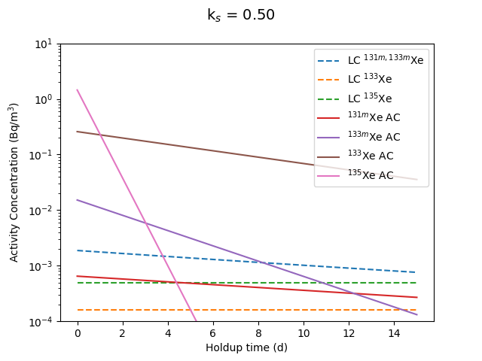
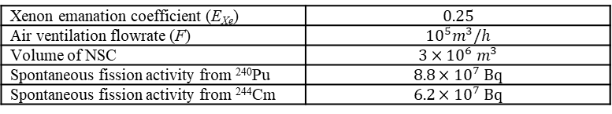
Estimating radioxenon production and release from the FCM – a first indication using a static model
Using estimates of the original reactor inventory decayed to present day it is found that three isotopes will contribute to the SF activity: ^{240, (238)}Pu and ²⁴⁴Cm.
Xenon emanation coefficient (E_{Xe}) | $$0.25$$
Air ventilation flowrate (F) | $${10}^{5}m^{3}/h$$
Volume of NSC | $$3×{10}^{6} m^{3}$$
Spontaneous fission activity from ²⁴⁰Pu | $$8.8×{10}^{7} Bq$$
Spontaneous fission activity from ²⁴⁴Cm | $$6.2×{10}^{7} Bq$$
The model predicts that around 0.1 mBq/m³ of ¹³³Xe present in the air volume of the NSC. Detectable using a Q_{B} for an holdup time < 2 weeks. ^{133m}Xe detectable for t_{H} < 1 week, ¹³⁵Xe : t_{H} < 4 days, and ^{131m}Xe not detectable.
An increase of k_{s} from 0 to 0.5 will increase the radioxenon concentration a factor of two.

Slide 11
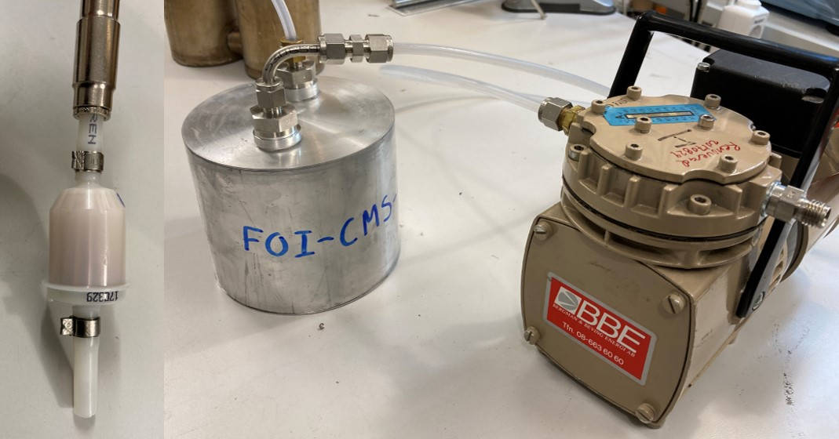
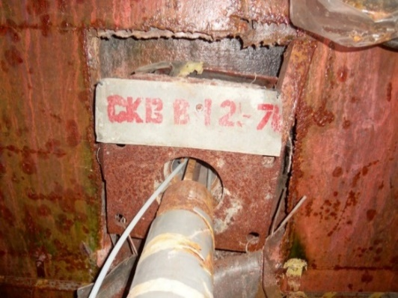
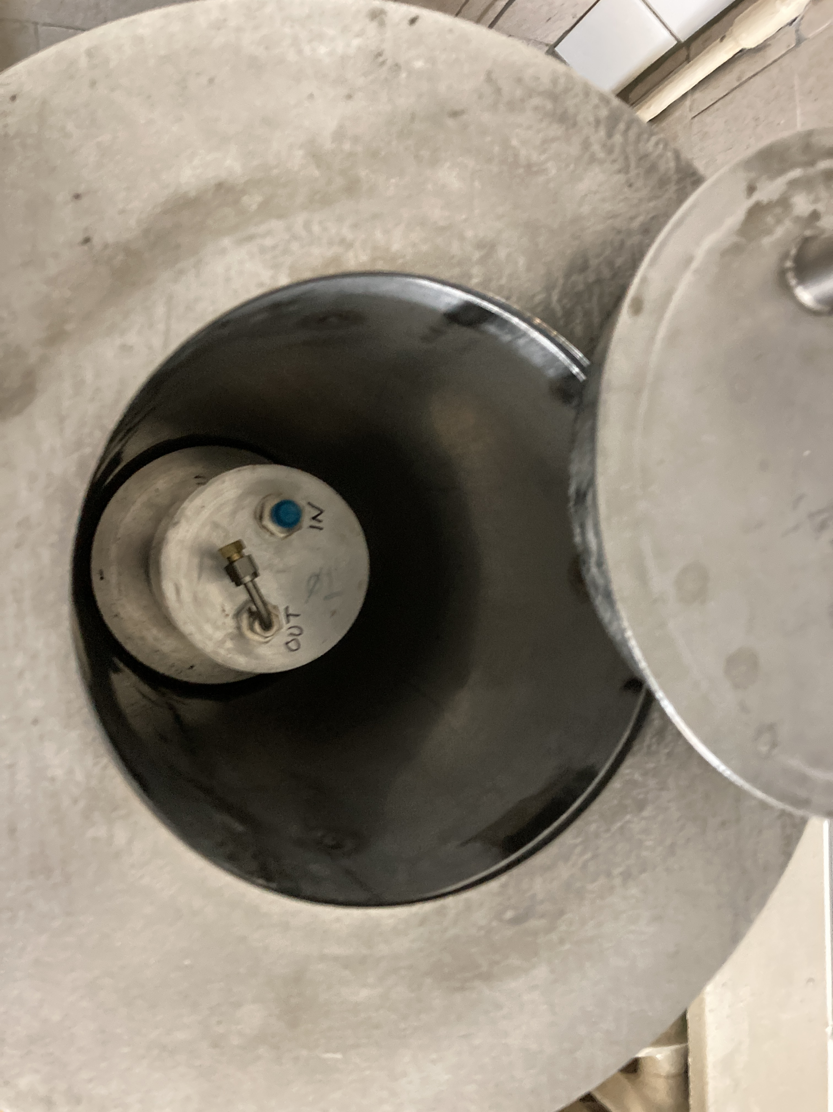
Initial studies
To investigate if the radioxenon activity is too high for the present Q_{B} – measurement protocol, a simple sampling system was designed to measure activities above ~1 Bq/m³.
Before the invasion, two samples were collected and measured, indicating that the ¹³³Xe activity concentration is below ~1 Bq/m³.
Sampling equipment (CMS trap, filter, and pump).
Sampling in borehole
Measurement on HPGe
at ISPNPP laboratory.

Slide 12
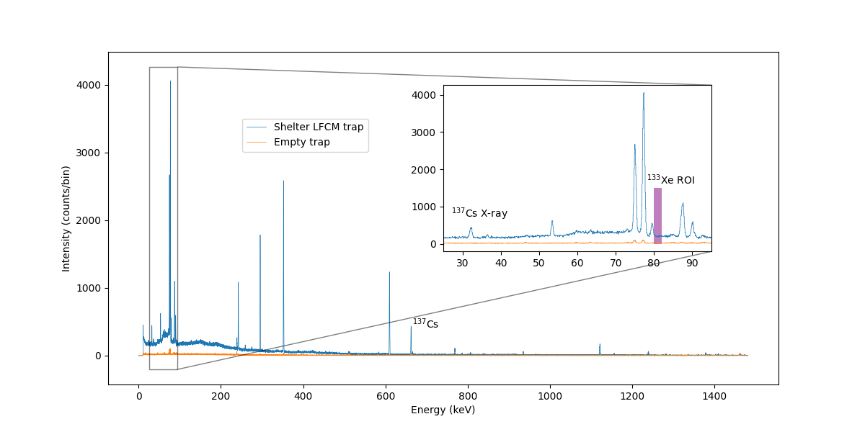
Initial studies
First sample contained NOM- materials and ¹³⁷Cs from contamination of outside of trap. The second sample contained only NOM.
No xenon or iodine were found.
This indicates that the xenon activity concentration is below a few Bq/m³, and that the Q_{B} will be a suitable system for further studies.
Additional measurements are planned to be conducted in the near future.

Slide 13
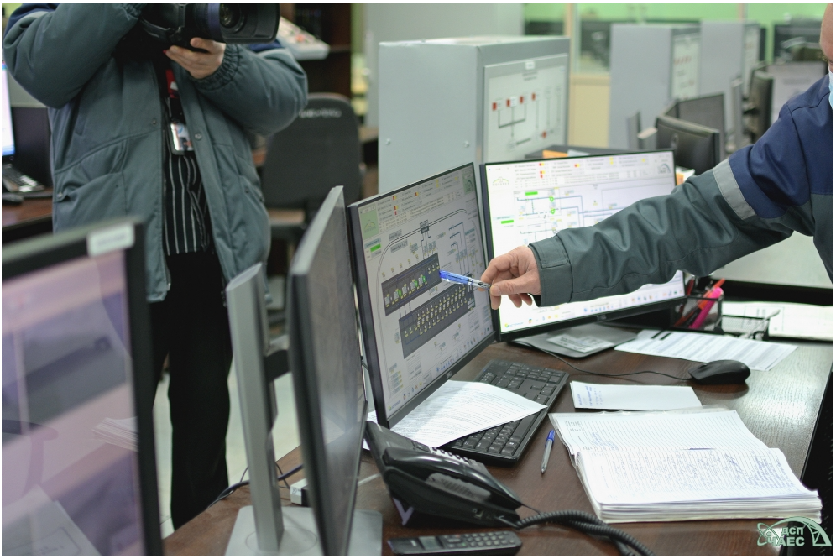
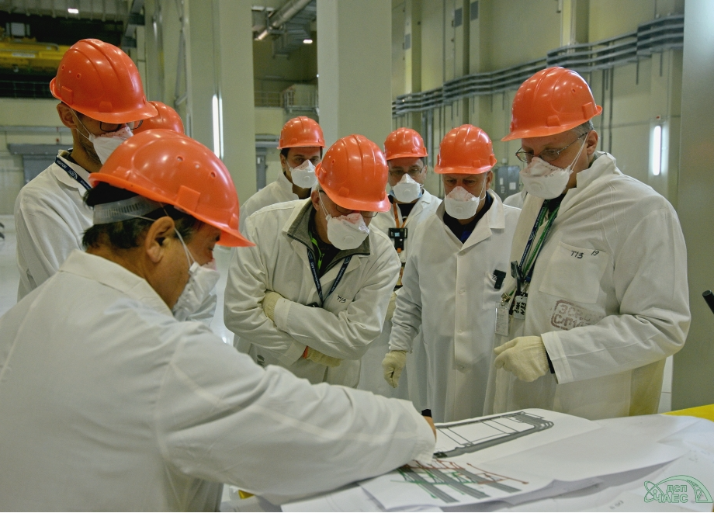
Air sampling in the NSC using the Q_{B}
The plan is to continue this project with the second step, using a Q_{B} to measure NSC air for 3-4 months.
The radioactive environment does not allow to place the system inside the SO.
A suitable position in the NSC has been identified.

Slide 14
Conclusions and outlook
We propose a novel method to address the issue of criticality safety at the NSC.
Initial measurements indicates that the Q_{B} – system is well suited for this purpose; additional measurements are needed to confirm this.
A static model indicates that the radioxenon activities could be at detectable levels.
A more elaborate, dynamic model is being developed, taking into account changes in the fission rate.
If the measured levels inside the NSC are at normal atmospheric background levels, additional measurements of this background will be necessary.
We intend to continue this project as soon as possible.

Slide 15
The authors want to thank the Chernobyl Nuclear Power Plant for fruitful cooperation, and the Swedish Radiation Safety Authority (SSM) for financing part of the work described in this report, including the visit to Chernobyl by staff from FOI and Uppsala University.

Slide 16
